Slide 1
Law, Ethics and Governance for All Leaders, including an Overview of New and Emerging Issues
AJG/LEGAL ONE: Monday Madness - Bullying, Discrimination Law and Public Schools: Navigating an Ever Changing Legal Landscape
September 16, 2024

Slide 2
Presenters
David Nash, Esq., Director of Legal Education and National Outreach
Rebecca Gold, LEGAL ONE Consultant
Dr. Charles Ford, Superintendent – Monmouth County Vocational School District
Dr. Rosetta Treece, Superintendent – Hopewell Valley Regional School District

Slide 3
Great Partnership
LEGAL ONE partnership with Arthur J. Gallagher, Alliant, New Jersey Schools Insurance Group
Upcoming training and podcasts
School Law Central

Slide 4
Monday Madness Sessions
FREE Sessions
August 12 – Never Crossing the Line! Understanding and Enforcing Student and Staff Boundaries
August 19 - Is Your Staff Ready for the New School Year? Implementing Sound HR Protocols
September 16 - Bullying, Discrimination Law and Public Schools: Navigating an Ever-Changing Legal Landscape
September 30 - The Role of Schools: Understanding the Parameters of Political Speech for Staff and Students in Crazy Times! - Registration

Slide 5
The LEGAL ONE Podcast
The LEGAL ONE Podcast - https://www.thelegalonepodcast.com/
Schools and Athletics (Alliant)
August 19 - Addressing Student Athlete Mental Health
September 2 - New Rules for Student Athlete Clearance
September 9 – The New Title IX
Schools and Human Resources (Arthur J. Gallagher)
September 30 – October 28

Slide 6
Upcoming Podcast Episodes
September 30 – Don’t Cross that Line! Creating a Clear Staff Code of Conduct
October 7 – Effectively Addressing Sexual Harassment Claims in Schools
October 14 – How Schools Can Be Family-Friendly to Staff and Still Operate Efficiently
October 21 – Staff Evaluation and Accountability… Beyond Staff Observations
October 28 – Ensuring Legally Sound HR Protocols

Slide 7
Upcoming Workshops
December 5, 2024, 10 am – 12 noon – The Role of Schools in Navigating Difficult Conversations Around Politics, Gender, Race, Religion and Other Sensitive Topics
February 13, 2025, 10 am – 12 noon – Understanding Evolving Legal Obligations for Schools and Law Enforcement

Slide 8
Today’s Topics
Understanding the Stakes
Scenario
Relevant Laws
Framework for Addressing Discrimination Claims
Framework for Addressing HIB Claims
Effective Investigations
Emerging Legal Issues
Action Steps

Slide 9
Understanding the stakes

Slide 10
Why This Matters
Potential for significant impact on physical and emotional well being for students and staff, including increased risk of suicidal ideation
HIB/Discrimination Claims undermine ability of students AND staff to focus on the task at hand
Potential legal liability skyrockets if districts fail to identify and respond to issues, or respond ineffectively
Exposure to potential punitive damages, not covered by insurance

Slide 11
scenario

Slide 12
Scenario - A Tangled Web!
Jenny has just begun middle school as a 6th grader student in the Safe Haven School District.
She is invited to a Halloween Party at the home of another student, Amanda, who she doesn’t know very well, but who has seemed nice to Jenny over the first 7 weeks of the school year.
Jenny is excited to go. Her parents gave her permission once they were assured by Amanda’s parents that there would be proper adult supervision at all times.

Slide 13
Scenario (cont’d)
Jenny is excited to go, since she doesn’t have many friends yet at the middle school.
Jenny’s father drops her off at 6 pm and tells her he will pick her up at 10 pm.
Jenny is greeted at the door by Amanda’s parents, who tell Jenny that the party is downstairs in the basement.
Jenny proceeds downstairs and sees about two dozen students, some wearing masks, others not.
Jenny is taken aback. She didn’t know if she was supposed to wear a costume or not and wants to fit in.

Slide 14
Scenario (cont’d)
Jenny’s mother receives a text message from Jenny at 8:30 pm saying “Please come get me. Not feeling well.”
Jenny’s father arrives shortly thereafter. Jenny is waiting in the driveway and immediately gets in the car. She appears shaken and upset.
Her father asks if everything is ok, and Jenny shakes her head Yes, but doesn’t speak. She is silent on the ride home.
The next morning, she tells her mother that she is still sick and doesn’t want to go to school. Jenny never misses school so her mother doesn’t question her, and calls in to the school.

Slide 15
Scenario (cont’d)
When Jenny’s mother calls in, the call is transferred to the school principal, Mr. Jones. Mr. Jones says, “Ms. Watson, I am glad you called. I can’t imagine how upset you must be. Please be assured we will get to the bottom of this.”
Jenny’s mother asks the principal what he is talking about.
The principal goes on to explain that a video is circulating on social media that shows several students, all wearing masks except for one, joking about how this is the “best party ever. Just ask Jenny. She knows how to take care of us guys real good!” All the boys then start laughing and the video ends.
Jenny’s mother recognizes the one unmasked student and tells the principal he is Jeremy Williams. Ms. Watson says that she knows Jeremy is a “little weird,” since he and Jenny went to the same elementary school, and says that she believes he has some sort of “a mental issue.”

Slide 16
Scenario (cont’d)
The principal is aware that Jeremy is a classified student who has a history of behavioral issues related to not understanding boundaries.
That morning, Jenny’s first period teacher, Mr. Johnson, comes in to the principal’s office and closes the door. He says “I can’t get my class to focus. Everyone keeps talking about that video.” He then says “Between you and me, I think Jenny may have brought this on. She always seems so desperate to get the attention of boys in class. Always flirting. Sometimes she gets the boys to say stuff. I keep telling Jenny after class to think about the image she is putting out to the world. But she just doesn’t listen.”
What steps should/must the school district take? What laws come into play?

Slide 17
Relevant laws

Slide 18
Laws You Should Be Aware Of
Memorandum of Agreement Beetween Education and Law Enforcement
New Jersey Law against Discrimination – N.J.S.A. 10:5-12
New Jersey’s Anti-Bullying Bill of Rights
New Jersey Conscientious Employee Protection Act (CEPA)
New Jersey Equal Pay Act
NJ CROWN Act
Americans with Disabilities Act
Title VI and Title VII of the 1964 Federal Civil Rights Act
Title IX of the Education Amendments of 1972
Equal Pay Act of 1963 (EPA)
Equal Protection Clause of the 14th Amendment
The Age Discrimination in Employment Act of 1967 (ADEA)
The Individuals with Disabilities in Education Improvement Act (IDEIA/IDEA)
Section 504 of the Rehabilitation Act of 1973
Pregnant Worker’s Fairness Act (PWFA) – 2014

Slide 19
Protected Characteristics
Employers (including parochial schools and public school districts) may not discriminate against staff or students based on:
Race
Creed
Color
National origin
Ancestry
Age
Genetic information
Pregnancy
Sex
Religion
Disability
Military service
Atypical cellular blood trait
Nationality
NJ LAD
Marital/domestic partnership/civil union status
Affectional or sexual orientation
Gender identification or expression
Hairstyle

Slide 20
NJ Law Against Discrimination
Enacted in 1945, first of its kind state civil rights law
Provides strong protections based on a wide range of protected characteristics
Covers employment, places of public accommodation, housing, business transactions
Amended in 1992 to cover sexual orientation
Amended in 2006 to cover gender identity
2007 – LW v. Toms River – applies to students, requires comprehensive, pro-active approach
Amended in 2018 – Equal Pay Act
Amended in 2019 – CROWN Act
Expands protections provided under federal law
NO NEED TO PROVE INTENT TO DISCRIMINATE
Generally relied on by plaintiffs more than comparable federal law

Slide 21
NJLAD Punitive Damages Requirements
Punitive damages will not be covered by the district insurance carrier
A LAD claim for Punitive Damages requires the Plaintiff to prove two things by clear and convincing evidence
Actual participation by upper management or willful indifference, and
Especially egregious conduct
N.J. Stat. Sec. 2A:15-5.12

Slide 22
“Upper Management”
Definition:
Determining who qualifies as “upper management” is a fact-sensitive inquiry that “does not depend on labels or titles but on whether an employee possesses significant power, discretion and influence.”
Aguas v. State, 220 N.J. 494, 529 (2015)
Example:
A Vice Principal who could have acted, but refused to do so when a student complained of racial harassment.
VP could be found to have actual or constructive knowledge of the harassment based on student filed reports
VP “could be liable in her personal and official capacity by failing to adequately address student’s race-based harassment complaint.”
George v. BOE, 34 F.Supp. 3d 442 (D.N.J. 2014) (July 23, 2014)

Slide 23
Title IX April 2024 Regulations Effective August 1, 2024
Title IX Regulation: 1,577 pages:
https://www2.ed.gov/about/offices/list/ocr/docs/t9-unofficial-final-rule-2024.pdf
USDE Title IX Fact Sheet:
https://www2.ed.gov/about/offices/list/ocr/docs/t9-final-rule-factsheet.pdf
Brief (Chart) Overview of Key Provisions of the Department of Education’s 2024 Title IX Final Rule
https://www2.ed.gov/about/offices/list/ocr/docs/t9-final-rule-summary.pdf
Resource for Drafting Nondiscrimination Policies, Notices of Nondiscrimination, and Grievance Procedures under 2024 Amendments to the U.S. Department of Education’s Title IX Regulations
https://www2.ed.gov/about/offices/list/ocr/docs/resource-nondiscrimination-policies.pdf

Slide 24
Title IX and Parental Rights
See page 237 - Section 106.6(g) remains consistent with the 2020 amendments, which provided that, although the student would remain the complainant or respondent in situations involving a minor, “the parent or guardian must be permitted to exercise the rights granted to the party . . . whether such rights involve requesting supportive measures or participating in the process outlined in the recipient’s grievance process.” 85 FR 30453. As further explained in the 2020 amendments, when the party is a minor or has an appointed guardian, “the parent or guardian must be permitted to accompany the student to meetings, interviews, and hearings during a grievance process to exercise rights on behalf of the student, while the student’s advisor of choice may be a different person from the parent or guardian.” Id.
See pages 863-866. The commentary indicates, that absent an emergency situation, disciplinary sanctions should not be imposed on students until after all appeals have been heard and decided upon. That would mean greater delays in imposing discipline in sexual harassment based cases than in any other student disciplinary proceedings. Districts should understand the steps to take if they believe there is an emergency situation and the possible flexibility suggested to allow removal of the alleged offender from participation in extracurricular activities for non-punitive reasons.

Slide 25
Resources
The New Title IX Rules: What is included, and how will they impact students’ rights? (YouTube):
https://www.youtube.com/watch?v=F8a0RKmT6GQ
Overview of the New 2024 Title IX Regulations
https://www.youtube.com/watch?v=O_k3Bg6PabU
Webinar – Title IX Regulations
https://www.naicu.edu/issues-advocacy/title-ix-regulations-update-2024

Slide 26
Title IX Settlement – Newark School District
August 2023 OCR Settlement with Newark Public Schools
Requires district to take extensive actions related to providing notice, conducting investigations, coordinating with outside entities (law enforcement, IAIU), responding to incidents, maintaining proper records, providing support and appropriate follow up, ensuring training for staff and students, and gathering data on ongoing basis regarding school climate.
Need coordination Title IX Coordinator and Anti-Bullying Specialists/Coordinator

Slide 27
Framework for addressing discrimination claims

Slide 28
Review of General Discrimination Law Standards
Direct Evidence of a School District’s Discriminatory Animus:
This is the “easier” claim
There is usually compelling, direct evidence (emails, documents, recordings, etc.) of motive and intent to discriminate, saying that the plaintiff was denied something by the defendant because of their protected characteristic.

Slide 29
Review of General Discrimination Law Standards
Indirect evidence sufficient to make out a prima facie case on which a School District’s discriminatory animus can be inferred.
This is the “harder” claim to prove
The Plaintiff bears the initial burden of establishing a prima facie case of discrimination under the 3 step, burden-shifting framework of McDonnell Douglas Corp. v. Green, 411 U.S. 792 (1973) by a preponderance of the evidence.
Preponderance of the evidence means “more likely than not” that the alleged harassment occurred.
Lesser standard that Criminal Court’s “beyond a reasonable doubt.”
School may find that discrimination / harassment occurred even if law enforcement chooses not to pursue a criminal investigation

Slide 30
Review of General Discrimination Law Standards
Step 1 – Plaintiff – Staff Member’s First Burden
The Plaintiff must show that:
S/he is a member of a protected class;
S/he is qualified for the position;
S/he suffered an adverse employment action
Examples include termination, denied a raise/promotion, forced to resign/retire, etc
The circumstances surrounding her adverse employment action gives rise to an inference of discrimination
Example – a male employee was allowed to do something when a woman in the same/similar position was not

Slide 31
Proof of Discrimination
Step 2 – Defendant’s Burden
If the Plaintiff satisfies the first burden, the burden shifts to the Defendant to rebut the Plaintiff’s claim by “articulating some legitimate, nondiscriminatory reason” for the adverse employment action.

Slide 32
Review of General Discrimination Law Standards
Step 3 – Plaintiff’s Second Burden
If the Defendant meets its burden of the McDonnell Douglas test, the Plaintiff must show that the Defendant’s proffered reasons are pretextual, and are not the real motivation for the adverse employment action.
To show that the proffered reasons are pretextual, the Plaintiff must present sufficient evidence to allow a reasonable person to either:
Disbelieve the Defendant’s articulated legitimate reasons; or
Believe that an invidious discriminatory reason was more likely than not a motivating or determinative cause of the Defendant’s actions.

Slide 33
Options Outside of School District
NJ Department of Law & Public Safety/Division on Civil Rights (DCR)
4 Regional Offices (Trenton, Atlantic City, Newark, Camden)
The US Department of Education/Office for Civil Rights (OCR)
Develops and implements Regulations
Manages Complaints
Investigation & Enforcement
Education
12 Regional Offices
State/Federal Court system
Federal or State law
Binding in that jurisdiction

Slide 34
AAO, ABS and Conflict of Interest
NJ Anti-Bullying Bill of Rights revised regulations prohibit ABS from investigating someone in the same bargaining unit
Case law prohibits other investigations of someone in same unit such as AAO investigations
32 NJ PER ¶88 County of Hudson, and AFSCME Council 52, Local 2306, April 27, 2006
PERC’s Director of Representation granted a county employer’s unit clarification petition and excluded an internal affairs investigator’s position from a negotiations unit
What if allegation is raised regarding BA or superintendent?

Slide 35
Framework for addressing hib claims

Slide 36
Key Aspects of NJ Definition of HIB
Conduct involves alleged student victim
Could take place anywhere
Could involve multiple school districts
Motivated by actual or perceived characteristic (through eyes of victim)
Substantial disruption or interference with orderly operation of school or rights of others
Harm (1 of 3) –
physical or emotional harm to self or property, or fear of harm; OR
Demeaning to student or group student is part of; OR
Creates hostile educational environment

Slide 37
Key Questions/Issues
Is there an allegation of HIB?
Is there an allegation of discrimination based on a protected class? If so, have proper added steps been followed (notifying AAO, Title IX Coordinator, law enforcement, etc. as necessary)
Is there no allegation of HIB by a parent or student but alleged behavior that you know meets New Jersey’s definition of HIB?
Does your local policy allow for a preliminary determination?
Was the incident report and investigation initiated in a timely fashion?
Is there evidence of Code of Conduct violations? Have they been addressed immediately?
Has the district gathered information quickly to reduce potential for a tainted investigation?

Slide 38
Key Questions/Issues
Is there evidence of a “bias-related act”?
Has the investigation process been spelled out to the relevant parties?
Ensuring safety while investigation under way
Conducting a legally-defensible investigation
Reaching clear conclusions, writing a report that can stand on its own
Conducting required hearings, with proper guardrails and procedures

Slide 39
Systemic Approach
Focus on school climate, culture
Identifying patterns and trends
Assessing all aspects of district operations that may impact potential claims, including:
Curriculum, supervision in less structured settings, working with student leaders to promote responsible information sharing

Slide 40
Effective investigations

Slide 41
Key HIB Investigation Questions/Issues
Has the 338 Form been completed by someone? (staff person if parent won’t)
If district does a preliminary determination did policy allow it? Was required process followed?
Were key statements taken the same day?
Did interviews involve 2 staff members?
If staff member is accused, were proper steps followed?
Was electronic evidence identified, preserved, taken down from social media, reported to law enforcement if necessary?

Slide 42
Key HIB Investigation Questions/Issues
Were key players told not to discuss issues/interfere with investigation?
Does the written report clearly review each element of the HIB definition? Does it clearly identify the evidence to support/refute each element?
Did the investigator apply the proper “preponderance of the evidence” standard?
Did the investigators take reasonable steps to assess credibility?

Slide 43
Key Staff Member Investigation Issues
Is there a protected class?
Was AAO and/or Title IX Coordinator notified?
Were staff member due process rights protected?
Were steps taken to protect confidentiality, ensure no additional harm occurs during investigation period?
Do issues also require notice to Institutional Abuse Investigation Unit? Law Enforcement?
If staff members resign during pending investigation, are issues covered under the Pass the Trash law, or mandated to be reported to the State Board of Examiners?

Slide 44
Emerging legal issues

Slide 45
Emerging Issues
Artificial Intelligence
Expanded Protections for Religions Expression for Staff Members – See Bremerton
Expanded Right to Bring Discrimination Claims Related to Starting Salaries (Equal Pay Act), Staff Transfers – See Muldrow
Expanded Protections for Non-Certificated Staff – PL 2021, c.66
Expanded Protections for Student Expression Outside the School Environment – Levy v. Mahanoy Area SD
Politicization of issues related to diversity, equity, and inclusion and issues related to gender identity
Increasing litigation

Slide 46
Action steps

Slide 47
Consider …
Your district’s recent history regarding HIB, discrimination claims
The level of staff turnover
The clarity of current policies and protocols
The level of consistency in implementation of policies, conducting of investigations, effectiveness of remedial steps
Changing student demographics
Your school climate

Slide 48
Conclusion
Thank you for choosing professional development with LEGAL ONE!
Visit our website for more courses that can support your work at http://www.njpsa.org/legalonenj/
Participants are authorized to use the LEGAL ONE materials provided in this training to offer turnkey training within the respective participant's school district or place of employment, provided that participants provide proper credit to LEGAL ONE for having developed said materials and further provided that such turnkey training is offered at no charge.
If you have any questions about this presentation or suggestions for future seminars, please send an email to legalone@njpsa.org

Slide 49
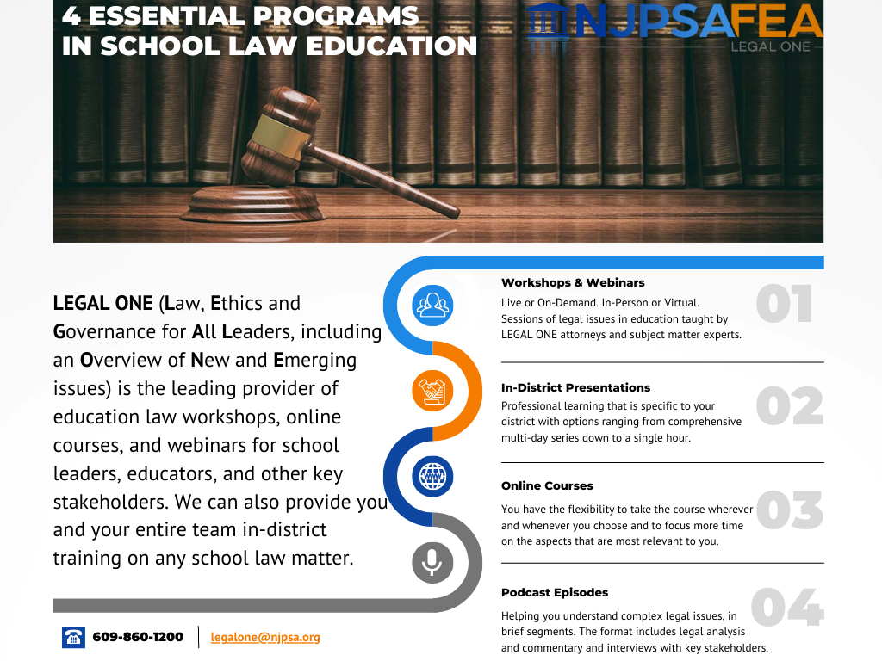

Slide 50
About the LEGAL ONE PODCAST
As the leading provider of school law training, the LEGAL ONE team of school law experts is pleased to offer the LEGAL ONE Podcast, a weekly podcast that helps you understand complex legal issues. Each episode is hosted by a LEGAL ONE attorney and/or an attorney working in partnership with LEGAL ONE. The format includes legal analysis and commentary and interviews with key stakeholders.
Available in Apple Podcasts and Spotify
LISTEN NOW

Slide 51
HIB Law Update
DATE
THURSDAY, NOVEMBER 21, 2024
WORKSHOP
TIME
9AM TO 3PM
PRESENTER
Participants will learn about major changes in state and federal statutes, regulations, guidance and case law that have a major impact on implementing New Jersey's Anti-Bullying Bill of Rights. This will include a review of new case law regarding parental, student and staff rights. Participants will also learn about new case law regarding the intersection of bullying and special education. Participants will also consider how to respond to growing trends regarding hate crimes and emerging forms of discrimination. Finally, participants will gain an understanding of the ever evolving use of social media to engage in cyberbullying, and the need for students AND staff members to understand social media boundaries.
DAVID NASH, ESQ., DIRECTOR OF LEGAL EDUCATION AND NATIONAL OUTREACH
FEE
$125 MEMBERS/$150 NON-MEMBERS
LOCATION
LIVE ONLINE
CLICK TO REGISTER
NOTE: All professional development POs are to be issued to FEA and sent to feasupport@njpsa.org; "Member" pricing applies only to active NJPSA members.

Slide 52
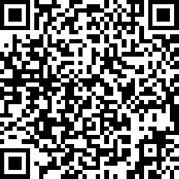
Certificate & Evaluation
Today’s professional development certificate is available to save/download at the end of a brief evaluation.
https://www.surveymonkey.com/r/LO-AJG-240916
Please take a few minutes to let us know what you thought of the session!

