Slide 1
“Keeping Dollars in the Classrooms”
ERIC West
Sub-fund Educational Meeting
Friday, May 31
10:00am - 12:00pm
ZOOM

Slide 2
Dominick Cinelli
Bob Gemmell
Sub-fund Administrators
ERIC West Sub-fund

Slide 3
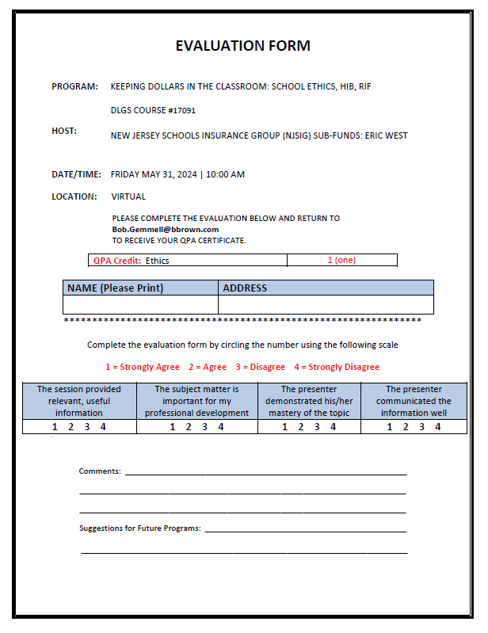
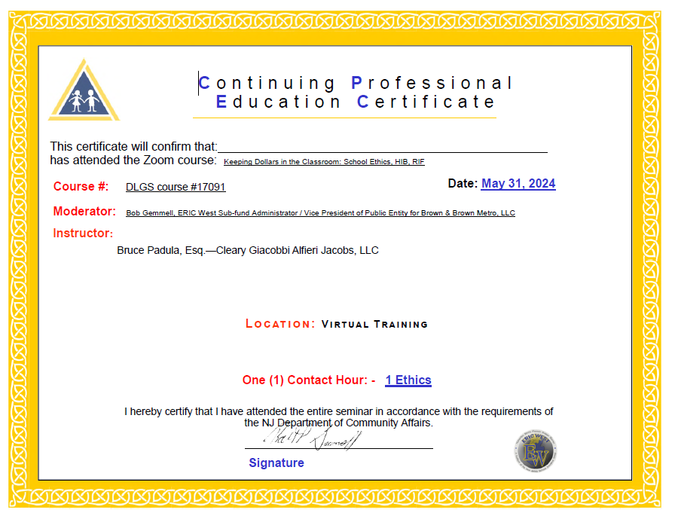
Evaluation & Certificate

Slide 4
Throughout the presentations, if you have any questions, please put them in the chat box.

Slide 5
PRESENTATIONS:
NJSIG’S EMPLOYMENT PRACTICES HOTLINE ATTORNEY (NEPHA)
Bruce Padula
Cleary Giacobbe Alfieri Jacobs, LLC
RETURN TO WORK / MODIFIED DUTY
Joanna Radomicki
NJSIG Member Services & Loss Control Representative

Slide 6
Jill Deitch, Esq.
Executive Director
NJSIG

Slide 7
NJSIG UPDATE
Vacant buildings policy changes
E&O to be brought in-house
Appraisals (85%)
Surplus
Safety Grant portal is open!
Underwriting Application Portal is live!

Slide 8
Joe Semptimphelter
Sr. Business Development Specialist
NJSIG

Slide 9
VALUE ADDED SERVICES
NJSIG New Marketing Materials

Slide 10
NJSIG UPDATES
SAFETY GRANT - CLOSING SOON!
Don’t forget to get your Safety Grant applications in!
Safety Grant Portal will close June 1st.
Contact:
JSemptimphelter@njsig.org
P: (609) 386-6060 x3044
UNDERWRITING APPLICATION - NOW OPEN!
the underwriting online application portal is now live! Please submit your applications asap!

Slide 11
Bruce W. Padula, Esq.
Partner
Cleary | Giacobbe | Alfieri | Jacobs, LLC

Slide 12
Keeping Dollars in the Classroom: School Ethics, HIB, RIF May 31, 2024
Bruce W. Padula, Esq.
CLEARY | GIACOBBE | ALFIERI | JACOBS

Slide 13
Introduction
The professional conduct of New Jersey School Board members is governed by the New Jersey School Ethics Act “Act,” N.J.S.A. 18A:12-24, et seq.
The Act is interpreted by The School Ethics Commission
In Advisory Opinions and Decisions

Slide 14
The New Jersey School Ethics Act
Mandates that members of boards of education avoid conduct which violates their public trust or which creates a justifiable impression that the public trust is being violated.
Identifies prohibited activities that would be conflicts of interest
Includes a code of ethics for school board members

Slide 15
School Official Ethics School Official Roles and Responsibilities
N.J.S.A. 18A:12-2 – Board Member Conflict of Interest Law
Nepotism Regulation – N.J.A.C. 6A:23A-6.2
School Ethics Act - N.J.S.A. 18A:12-21 et. seq.

Slide 16
School Official Ethics
Nepotism Regulation
School ethicS ACt
"Relative“ - spouse, natural or adopted child, parent, or sibling of a school official
"Relative" – individual's spouse, civil union partner…domestic partner…, or the parent, child, sibling, aunt, uncle, niece, nephew, grandparent, grandchild, son-in-law, daughter-in-law, stepparent, stepchild, stepbrother, stepsister, half-brother or half-sister, of the individual or of the individual’s spouse, civil union partner or domestic partner, whether the relative is related to the individual or the individual’s spouse, civil union partner or domestic partner by blood, marriage or adoption.

Slide 17
Code of Ethics for School Board Members N.J.S.A. 18A:12-24.1
Not surrender judgment to special interest or partisan political groups
Not use the schools for personal gain or gain of friends
Maintain confidentiality
Appoint most qualified personnel after consideration of recommendation of superintendent.
Support and protect school personnel in proper performance of their duties
Refer all complaints to the chief school administrator; act only after failure administrative solution

Slide 18
Common ISSUES
First Amendment
Social Media
Conflict of Interest
NJ Learning Standards and Curriculum Design
“Hot Topics,” i.e. Transgender Policies/Sexual Health and Physical Education/COVID-19

Slide 19
a) No school official or member of his immediate family shall have an interest in a business organization or engage in any business, transaction, or professional activity, which is in substantial conflict with the proper discharge of his duties in the public interest.
Advisory Opinion (A17-04). A board member would not violate N.J.S.A. 18 A:12-24(a) or (d) of the Act if he continued his employment with an architectural firm that is contracted by the Board, but he must recuse himself from all discussions, actions, resolutions and votes pertaining to the area of architecture pursuant to N.J.S.A. 18A:12-24(c). (July 26, 2004).
Albanese v. Kazan (C33-16). A board member did not violate N.J.S.A. 18A:12-24(a),(c), or (g) when she contributed towards a GoFundMe page in support of a full day kindergarten and was photographed with members of a Facebook group in support of the full day kindergarten. She participated in these activities in her individual capacity as a taxpaying citizen, as opposed to acting in her official capacity as a board member or representative of the board, and she did not receive any unwarranted privileges in exchange for her support. (November 1, 2017).

Slide 20
a) No school official or member of his immediate family shall have an interest in a business organization or engage in any business, transaction, or professional activity, which is in substantial conflict with the proper discharge of his duties in the public interest.
Advisory Opinion (A01-23). A board member sought advice as to whether, in connection with the employment with a food services vendor, they could continue to work in the district without violating the Act. Based on the facts and circumstances presented, the SEC advised that, because the board member is ultimately subject to supervision from senior leadership, including the superintendent and building principal(s), it would be a conflict of interest for the bard member to continue working in the district while also serving as a member of the board. Therefore, the SEC recommended that the board member ask their employer to be reassigned to another school district. The SEC additionally advised that, while employed by the food service vendor, the board member would need to recused themselves from discussions and votes concerning their employer, and regarding competing vendors or entities that offer the same (or similar) products or services as their employer).

Slide 21
b) Obtaining privileges, advantages, employment for self, family, others
Kearns v. Anthony (C18-01A). A board member was found to have used her official position to secure unwarranted privileges and advantages for herself and others, in violation of N.J.S.A. 18A:12-24(b), when she used her position as a board member to acquire mailing labels containing student information that were used to send mailings for a political campaign. The board member was censured. (October 23, 2001).
Holstein v. Raftopoulos-Johnson (C08-16). A Board member voted on a resolution that would result in her child attending Port Jervis School District, without payment of tuition, contravention of the Commissioner’s directive, and in violation of a send-receive agreement with High Point Regional School District. “Respondent used her position to secure an unwarranted privilege and/or advantage, namely “Board permitted” attendance at a school unauthorized by the Commissioner and free tuition for this unauthorized attendance.”

Slide 22
b) Obtaining privileges, advantages, employment for self, family, others (cont.).
Advisory Opinion (A03-23). A board member who was previously employed as an administrator and special education teacher in another school district, asked whether, because of their education and experience, they could serve on the local special education parent advisory group, and advocate for students and their families in the district. Per the SEC, the board member’s service in the district would be a conflict because the public could view their role as an advocate to be in substantial conflict with their duties and responsibilities as a board member; as a mechanism through which they could use or attempt to use their official position to secure unwarranted privileges or advantages for others; and as a service that might reasonably be expected to prejudice their independence of judgment in the exercise of their official duties as a board member. Further, in advocating for a district student or family, the board member could be doing so in opposition, whether directly or indirectly, to district staff and administration, and in opposition to the board itself. Nonetheless, the SEC encouraged the board member to provide such services outside the district.
Notes:
In the Matter of Sheila Brogan (C71-20). A Board member was found to have violated N.J.S.A. 18A:12-24(c), when she did not recuse herself from a May 7, 2021 executive session, where the Board discussed a lawsuit, which the Board member had a personal interest in and had reason to know would be discussed in the executive session. The Commission adopted the ALJ finding of fact, but rejected the ALJ’s legal conclusion that the Board member did not violate N.J.S.A. 18A:12-24(c). The Commission determined that case precedent required them to find that the Board member was in violation of the statute. The Commission reasoned, “[w]hen a school official has a conflict of interest of which the public is aware, and that school official goes behind closed doors when that item is discussed, the situation creates a justifiable impression among the public that their trust is being violated.” Page 6 (citing Lacey Township Board of Education, Docket No. C12-94, at 3). Additionally, the Commission pointed to public advisory opinion A33-95, which advised that a board member who has a conflict prohibiting him from negotiating would be in violation of the Act if he sat on the board’s closed session strategy discussions. This advisory opinion followed the Superior Court-Appellate Division’s ruling in Scotch Plains v. Syversten, 251 N.J. 566 (App. Div. 1991) (School board member who had litigation pending against the district could not attend executive sessions of the board discussing that litigation). Page 6. Furthermore, the Commission emphasized that the Board member was aware that the pending litigation would be discussed in the executive session.

Slide 23
b) Obtaining privileges, advantages, employment for self, family, others (cont.).
Advisory Opinion (A09-23). Board counsel inquired whether the superintendent and the board secretary/business administrator, who are in a personal relationship, have a conflict. The Commission states that they are regarded as “others” because they are not married, and that neither can provide the other with an unwarranted privilege, advantage, or employment. The SEC advised that the superintendent should not be involved in any aspect of the board secretary/business administrator’s evaluation or supervision.
Advisory Opinion (A10-23). Board counsel inquired whether a board member is prohibited from being involved in matters related to the superintendent when their child is employed as student employee in an afterschool care program, and is supervised by a district employee, who is ultimately supervised by the superintendent. The SEC advised that the board member has a conflict with respect to the immediate supervisor of their child, and to all other employees and administrators up the chain of command, including the superintendent. Because the board member’s child is supervised by a member of the local education association, the board member also had to recuse themselves from all matters related to the local education association.
Notes:
NEW

Slide 24
IMO Sheila Brogan, Appellate Division 6/21/23
Board member appealed from a 2/25/22 final decision of the School Ethics Commission, which found that she had violated the School Ethics Act, N.J.S.A. 18A:12-24(c), with a recommended penalty of censure. Before a Commissioner decision had issued, board member filed a notice of appeal with the Appellate Division, 3/9/22. Commissioner concurred with the censure penalty 4/14/22.
Appellate Division found that it lacked jurisdiction, as the appeal was not from a final judgment or final agency action and dismissed the appeal.
App. Div. considers appeals from final decisions or actions of state administrative agencies or officers and does not review administrative decisions when there is a further “right of review before any administrative agency or officer, unless the interest of justice requires otherwise.
Notes:
a public member could justifiably believe that their objectivity was impaired when voting upon and executing the settlement. a public member could justifiably believe that their objectivity was impaired when voting upon and executing the settlement.

Slide 25
Schwartz v. Abedrabbo, Awwad and Clifton BOE et. als, APP. DIV, October 6, 2023
Appeal of SEC complaint dismissal, 1/25/2022. Appellate Division affirms
SEC. Petitioner alleged that board members violated the School Ethics Act,
specifically N.J.S.A. 18A:12-24.1 (e) of the Code of Ethics of School Board
Members, when they made anti-Israel and allegedly anti-semitic remarks
during a virtual public board meeting. Majority of board members’ remarks
made during “Commissioner’s Comments” section of the meeting were
critical of Israel’s treatment of the Palestinians.

Slide 26
Siegel v. Aziz , Westfield Board of Education, Union County, C18-23 (December 19, 2023)
The complainant alleged that the respondent violated N.J.S.A. 18A:12-24.1(e) because she allegedly made repeated racist, anti-semitic, and anti-Zionist public statements on her professional social media platform(s) and in an
academic publication and did so without using a disclaimer. In dismissing the complaint for failing to plead sufficient credible facts, the SEC stated, “Respondent’s statements, while controversial and likely perceived as offensive and hurtful to members of the district’s Jewish community as well as to the Jewish community as a whole, did not relate to the business of the
Board and/or its operations, nor was there a nexus between the social media page and/or academic publication to her Board membership.”
* Currently pending an appeal to Appellate Division.

Slide 27
EASY FIX
USE A DISCLAIMER

Slide 28
In a March 2019 decision, the SEC provided an indication of what an effective disclaimer could look like. In decision C64-18, the Commission reviewed an ethics complaint filed about social media posts. In the matter, a board member who was running for reelection was asked about why other candidates were blocked from participating in an online debate. The member responded that the blocking was related to harassment targeting her elementary school child. The complainant claimed that, in the context in which the response was made, the board member clearly identified the complainant’s child as the perpetrator of the alleged bullying, and asserted the comments were inaccurate and harmed the reputation of his child and spouse.
The SEC found that the social media comments were “clearly linked” to the member’s board membership and candidacy, and did not include a disclaimer such that it would have been reasonable for a member of the public to perceive that the statements were made in her board member capacity. In the decision, the SEC stated in a footnote:
A prominent disclaimer (caps/bold), such as, “the following statements are made in my capacity as a private citizen, and not in my capacity as a board member. These statements are also not representative of the board or its individual members, and solely represent my own personal opinions,” may have avoided the appearance — actual or perceived — that the statements were made in Respondent’s capacity as a Board member.

Slide 29
Pinto v. Cooper, Cusato, Parrino, Pedersen, et. al., Westwood Regional Board of Education Bergen County, C75-23
NJ Learning Standards and Curriculum – Board Ethics
Complainant alleged that Board member/Respondents provided inaccurate information regarding the NJ Learning Standards Health/Sex Education and the District’s curriculum
Respondents’ opinions not a violation of the Act
As long as not contrary to educational needs of ALL Children
Inclusive

Slide 30
SEC Complaint Dismissals 2021-23
SEC decided 29 complaints in 2021, 59 in 2022, 31 so far in 2023
Of the 29 complaints decided in 2021, 23 were dismissed;
Of the 59 complaints decided in 2022, 53 were dismissed.
Of the 47 complaints decided in 2023, 34 were dismissed.
In most instances of dismissal, Complainant failed to plead sufficient, credible facts to support a finding that Respondent violated a provision of the Code of Conduct or the Code of Ethics for School Board Members as alleged in the Complaint.
Only three complaints to date that have not been dismissed have not been adjudicated by the Commissioner of Education.
Fines for frivolous complaints – 2021 - $100; 2022 - $ 100, $500; 2023 - $100
School Ethics Commission Complaint Dismissals 2020 – 2023

Slide 31
OVERVIEW OF HARASSMENT, INTIMIDATION, BULLYING
1. Any gesture, written, verbal or physical act, including electronic communication
2. That is reasonably perceived as being motivated by an actual or perceived protected characteristic
3. Can be single incident or a series of incidents
4. Takes place on school property/school function; on school bus or off school grounds
5. Substantially disrupts classroom environment or harms student

Slide 32
HIB vs. Student Conflicts
Conduct that does not constitute HIB may nevertheless be a student conflict in violation of the Student Code of Conduct. Therefore, disciplinary action may still be appropriate.
Student Conflicts are not HIB
Conflict - disagreement, argument, fight or other action between people when they want different things, and everyone is equally involved.
During a conflict, name-calling, threats and other conduct that might look like bullying can occur. However, a conflict and bullying are very different. Unlike bullying, during a conflict people are equally involved in some type of disagreement. Conflict is considered mutual, meaning everyone is more or less evenly involved.
Bullying, by contrast, involves one-sided behavior, where one or more students are victims of unwanted or uninvited aggression that is reasonably believed to be motivated by a desire to physically and/or emotionally hurts the victim(s).
The behavior is not an attempt to positively or negatively address or resolve a problem.

Slide 33
Reporting and Investigating Allegations of HIB
N.J.S.A. 18A:37-15(b)(3)
Staff member or student relays incident to principal witnessed the incident or received reliable information
N.J.S.A. 18A: 37-15(b)(5)
Notifies parent(s) of HIB allegation and student(s) involved same day - Keep record of date, time, and manner of notification; also offer opportunity for counseling and other interventions

Slide 34
Reporting and Investigating
N.J.S.A. 18A: 37-15(b)(5)
Within two days of witnessing or learning of incident, the staff member who reported must provide the principal with a written report
Use confidential identifiers
Within (1) day of receiving verbal report, principal initiates HIB investigation with Anti-Bullying Specialist – N.J.S.A. 18A: 37-15(b)(6)(a)

Slide 35
Preliminary Determinations
Per N.J.S.A. 18A:17–46, if a school district’s policy permits a preliminary determination to be made on whether a reported incident or complaint is a report outside the scope of the definition of harassment, intimidation, or bullying pursuant to section 2 of P.L.2002, c. 83 (C.18A:37–14), the superintendent shall also provide annually to the board of education information on the number of times a preliminary determination was made that an incident or complaint was outside the scope of that definition for the purposes of the State’s monitoring of the school district.
The principal shall report to the superintendent if a preliminary determination is made under the school district’s policy that the reported incident or complaint is a report outside the scope of the definition of harassment, intimidation, or bullying, and the superintendent may require the principal to conduct an investigation of the incident, if the superintendent determines that an investigation is necessary because the incident is within the scope of the definition of harassment, intimidation, or bullying. The superintendent shall notify the principal of this determination in writing.
The NJDOE mandated form is also to be used even if a preliminary determination is made under the school district’s policy that the reported incident or complaint is a report outside the scope of the definition of harassment, intimidation, or bullying pursuant to section 2 of P.L.2002, c. 83 (C.18A:37–14). Similar to conduct investigated as HIB, the report shall be kept on file at the school but shall not be included in any student record, unless the incident results in disciplinary action or is otherwise required to be contained in a student’s record under State or federal law.

Slide 36
Investigation Tips
Complainant, Accused, and Witnesses will all be interviewed
Relevant documents, emails, and phone records will be requested
Information shared on a “Need to Know” basis
Complaints made in bad faith will be subject to discipline
School districts have the right to interview students without prior parent permission – Goss v. Lopez, 419 U.S. 595 (1975)

Slide 37
Preservation of Evidence
Collect any evidence of the incident that has been brought to your attention (written – i.e. text messages, notes, comments on social media, letters)
Physical items such as photos, videos, etc.
Make sure evidence is safe-guarded and entered into the record of the incident
Evidence preservation is important especially if there is an appeal of the decision

Slide 38
ALWAYS REMEMBER
Before an interview is concluded, ensure that the following has been asked and answered:
Who (did what; saw/heard what; was where; was affected; did you contact immediately after, if anyone)
What (happened; caused the incident; occurred before/after the incident; did you do right after the incident/comment)
Where (did the incident occur, where was the person at the time of the incident)
When (did the incident occur; when was the matter reported; when did the person learn of the incident)
Why (does the person think the conduct occurred; was the comment stated)
How (did the incident occur; how did the person learn of the incident; how did the you feel; how did you react after)

Slide 39
Investigation Report and Findings
A LITTLE EXPLANATION GOES A LONG WAY!
PREVENTS COSTLY MISTAKES

Slide 40
HIB Investigations
The HIB investigation must be completed within ten (10) school days from the date of the written report or from the date the Superintendent directs the principal to initiate an HIB investigation (following a preliminary determination). N.J.S.A. 18A:37-15(b)(6)(a).
The anti-bullying specialist may amend the report if there is additional information that was not available during the ten (10) school day period. N.J.S.A. 18A:37-15(b)(6)(a).
Within two (2) days of its completion, the results of the HIB investigation must be reported to the Superintendent. N.J.S.A. 18A:37-15(b)(6)(a)(b).
The Superintendent may decide to provide intervention services, establish training programs to reduce HIB and enhance school climate, impose discipline, order counseling, or take or recommend other appropriate action.
The Superintendent may also decide to seek further information.

Slide 41
Reporting Information to the Board & Parties
The Board of Education must be informed of the HIB investigation and results at the Board of Education meeting following completion of the HIB report. N.J.S.A. 18A:37-15(b)(6)(c).
Within five (5) days of informing the Board, the parents of the subject students and any accused staff member(s) must receive “information” in writing about the nature of the investigation and whether the District found evidence of HIB. N.J.S.A. 18A:37-15(b)(6)(d); N.J.A.C. 6A:16-7.7(a)(2)(xi).
The information should be sufficient for the parents/staff member(s) to understand why the alleged conduct did or did not constitute HIB. A summary of the investigation evidence should be referenced and a review of the applicable HIB criteria should be provided.
Remember FERPA and NJ Pupil Privacy Act restrictions!

Slide 42
HIB Hearings
After receiving the information, the parents and/or any accused staff member(s) may request a hearing before the Board of Education. N.J.S.A. 18A:37-15(b)(6)(d). The request for a hearing before the Board of Education must occur within 60 calendar days after receiving the written information about the investigation.
If requested, the hearing must occur within ten (10) days, and occur in closed, executive session. N.J.S.A. 18A:37-15(b)(6)(d).
Parents and any accused staff member(s) cannot be denied the opportunity to provide witnesses and appear before the Board of Education.
See Sadloch v. Cedar Grove Board of Education, OAL DKT. EDU 00619-14, decided March 25, 2015, adopted Commissioner Decision No. 216-15, June 23, 2015. (A failure to provide a staff member with an opportunity to be heard before the Board’s written determination may result in the expungement of the HIB record.)
Unreasonable time limitations may deprive parents and/or staff members with the due process that they are accorded under the law.
See Gibble v. Hunterdon Central Regional School District, OAL DKT EDU 02767-15, final decision (April 12, 2016) (parents were limited to 20 minutes and were precluded from presenting witnesses).

Slide 43
Resources from New Jersey Department of Education
HIB – Guidance for schools and parents, questions and answers on the ABR, HIB online tutorials, HIB model policy and guidance, and other HIB resources: http://www.state.nj.us/education/students/safety/behavior/hib/
School Climate and Culture – webinars, reports and other resources:
http://www.state.nj.us/education/students/safety/sandp/climate/

Slide 44
REDUCTIONS IN FORCE

Slide 45
Board Officers
A board secretary, assistant board secretary, school business administrator, or business manager of a BOE who serves for three consecutive years in that position holds his or her office under tenure, NJSA 18A:17-2a, provided the officer has devoted his or her full time to the duties of the office.
Walsh v. Laurel Springs BOE – board secretary who only worked full time a portion of the three years preceding her termination had not earned tenure

Slide 46
Secretaries and Clerks
A secretary or clerk holds his or her position under tenure after employment for three calendar years or three consecutive academic years together with employment at the beginning of the next successive academic year. N.J.S.A. 18A:17-2b.
Brenda Miller v. City of Newark

Slide 47
Tenure Rights
Tenure protects secretary/clerk from compensation decreases, even during RIF’s.
Custode v. Hackettstown Board of Education: A tenured secretary who was transferred to a lower-paying position in a RIF within her tenure could not have her salary reduced.
The tenure rights of secretaries and clerks are not to be transferred between different school districts due to these statues providing for teaching staff members as well.
Chinnis v. Lower Cape May Regional Board of Education: After working as a child study team secretary for three years under a de facto jointure commission, she was reassigned to a member district when the commission dissolved. However, her tenure did not carry over to the new position, making her subject to nonrenewal by her new employer.
Franklin Education Association v. Wallkill Valley Regional High School Board of Education: Secretaries were rehired in a new regional district following the discontinuation of their constituent district. The regional district was not obligated to acknowledge either their tenure status or their length of service.

Slide 48
Seniority
Staff members who are tenured are chosen for transfer or dismissal based on their seniority ranking. This ranking is conducted during their district service.
The State Board of Education at N.J.A.C. 6A:32-5.1 has established standards for determining seniority. These standards serve “a two-fold purpose: (1) to give a reasonable protection to professional staff members, and (2) to protect the school system by preventing seniority from operating in such a manner as to displace a qualified person with an unqualified one.”
Lautenschlager v. Jersey City Board of Education: In this case, a school district was responsible for determining the seniority status of five supervisors to then notify them of this status and place them on a preferred eligible list in order of seniority after getting rid of their positions.

Slide 49
When Seniority Applies
Seniority rights apply only in two circumstances
When a Reduction in Force occurs
When a vacancy occurs in the category of employment from which tenured teaching staff members were removed in a former RIF

Slide 50
Seniority
Mary McKennedy v. Board of Education of the Borough of Brielle, Monmouth County: The commissioner determined that even though a tenured teacher possessed a teacher of school studies endorsement (which she had never utilized), she could not assert seniority rights to a position occupied by a more senior tenured middle school teacher working under the same instructional endorsement, deemed highly qualified by the district in the subject area. According to the Commissioner, seniority rights are not inherently tied to one's highly qualified status, but rather to the duration of time during which the teacher actively taught the subject area (social studies) and the educational level (secondary) at which it was taught.

Slide 51
Creation of Categories
A teaching staff member earns seniority only within specific categories of employment.
N.J.S.A. 18A:28-13
Categories do not necessarily align with tenure positions or with certification endorsements. Seniority categories and job titles need not conform; indeed, job title is less important than duties performed in the determination of seniority category.

Slide 52
Administrative
N.J.A.C. 6A:32-5.1(1) – categories do not precisely match the endorsements on the administrative certificate, any one of which may qualify employment in several seniority categories
Mirandi v. West Orange Board of Education: A recently laid off high school assistant principal was not entitled to an assistant principal position at a junior high school.
Schifano v. Jersey City Board of Education: The tenure of an elementary school principal could not be restricted to only the “primary” level.
Koch v. Fair Lawn Board of Education: Junior high school vice principal and high school vice principal are distinct seniority categories; there is not an overarching category for vice principals.

Slide 53
Limitation by endorsement
The instructional subject areas, along with their respective seniority classifications, are determined by the endorsements granted by the State Board of Examiners.
Tote v. Mercer County Vocational-Technical School Board of Education: Each distinct vocational endorsement constitutes an individual seniority classification; for instance, the skilled trades-automotive mechanics endorsement is distinct from the production, personal, or service occupation-service station attendant endorsement.
In re Seniority Rights of Certain Teaching Staff Members in Edison Township: Seniority for driver education teachers is determined by their driver education endorsements rather than physical education endorsements.
Hudson County Area Vo-Tech Education Association v. Hudson County Area Vo-Tech Board of Education: The seniority of a vocational teacher was confined to their specific production, personal, or service occupation endorsement and could not be expanded to encompass related PPSO endorsements.

Slide 54
Questions?
Bruce W. Padula, Esq. - CLEARY GIACOBBE ALFIERI JACOBS
955 NJ 34 Matawan, NJ 07747
bpadula@cgajlaw.com
(732) 583-7474

Slide 55
Joanna Radomicki
Member Services & Loss Control Representative
NJSIG

Slide 56
Return to Work
GETTING BACK TO WORK AFTER AN INJURY

Slide 57
Hi!
I’m Joanna Radomicki
Joined NJSIG in 2016. Spent the last 8 years as Senior Claims Representative for NJSIG’s Workers’ Compensation department.
01
02
April 2024, transitioned to NJSIG’s Member Services department as Member Services & Loss Control Representative.
03
Representative for ERIC North, MOCSSIF, and NJEIF sub-funds.
04
Email: JRadomicki@njsig.org
Phone: 609-386-6060 x 3029

Slide 58
Workers’ Compensation
Accidents Happen!
Regardless of how safe an employer may try to make the workplace, on-the-job accidents and job-related illnesses occur
Workers’ compensation benefits are mandated by law
Provide medical care and compensation to injured workers on a no-fault basis
Income protection for employees

Slide 59
NJSIG’s WC Process
Step 1
Claim is reported to NJSIG
Step 2
Assigned to NJSIG WC Claims Adjuster
Acknowledgment letter sent to the district’s WC Claims Contact
Step 3
NJSIG directs treatment
Step 4
NJSIG directs care to a medical provider with similar return to work philosophy
Step 5
Medical DR is required to update NJSIG within 48 hours following each medical visit
Step 6
Claims Adjuster/Nurse Case Manager will relay update with diagnosis and treatment place back to the WC Claims Contact
NJSIG strongly suggests encouraging the injured employee to update the district immediately after medical visits.

Slide 60
Shared Goal:
WC Claims Contact discusses accommodations with WC Adjuster:
Full duty
Out of work
Modified duty
Employees who cannot fulfill their contractual obligations of their current role are entitled to 100% lost wages and benefits for one year.
Districts are encouraged to bring injured employees back to work on modified duty.

Slide 61
Modified Duty
Once modified duty is determined:
The doctor has identified the capabilities of the injured employee.
Employees are placed in suitable positions that accommodate their physical limitations

Slide 62
Return to Work Benefits
Saves Money
Increases morale among
entire workforce
Enhances Recovery
Encourages teamwork
Increases self-esteem

Slide 63
Working in Partnership
Help us help you!
District should create a comprehensive modified duty/return to work policy tailored to the specific needs of the district and their employees.
Discuss strategies for return to work plans.
Plan and execute communication between HR, supervisors, and staff safeguarding employee’s abilities and limitations and encouraging collaboration.
Remain consistent and positive!

Slide 64
Establishing a
Return to Work Program
Objective
Eligibility
Communicate
Clearly outline the district’s position on modified duty
Restrictions will be reviewed (adherence with medical clearance and provide appropriate accommodations)
Can be discussed with:
NJSIG WC Adjuster
Legal Counsel
HR/Supervisor
Outline the rights and responsibilities of the employee during the return to work process
Included but not limited to; expectations, attendance, adherence, and special considerations

Slide 65
Defining Modified Duty
District personnel should be encouraged to make a list of tasks that can be included in the return to work program. These tasks should include a wish list of items that are often not complete due to more important, urgent, or pressing tasks.
The list can evolve over time.

Slide 66
Key Takeaways:
·Paying 100% wages for up to 1 year following accident.
·Establish a return to work program.
Return to work programs allow the district to benefit from new opportunities for task completion.
·Establish a return to work program.
·Commit to open lines of communication.
·Develop a modified duty task list in advance that can evolve over time.

Slide 67
Thank You!!
JOANNA RADOMICKI - NJSIG

Slide 68
Bob Gemmell
ERIC West Sub Fund Administrator

Slide 69
Certificates of Insurance – UPDATED NJSIG Procedure
As of January 2, 2024 NJSIG has updated the certificate of insurance procedure as it pertains to Additional Insured Status.
This is to confirm that extensions of coverage are granted properly.
When being asked to provide additional insured status to a third party, be sure to include the ENTIRE original contract, agreement or other documentation that notates the request for additional insured.
When an outside entity is using our facilities, a facilities request form should be completed. This form outlines the insurance requirements and other information necessary for usage of your facility.

Slide 70
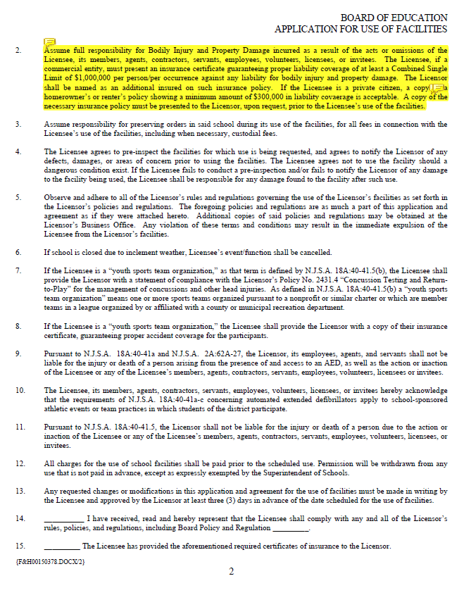
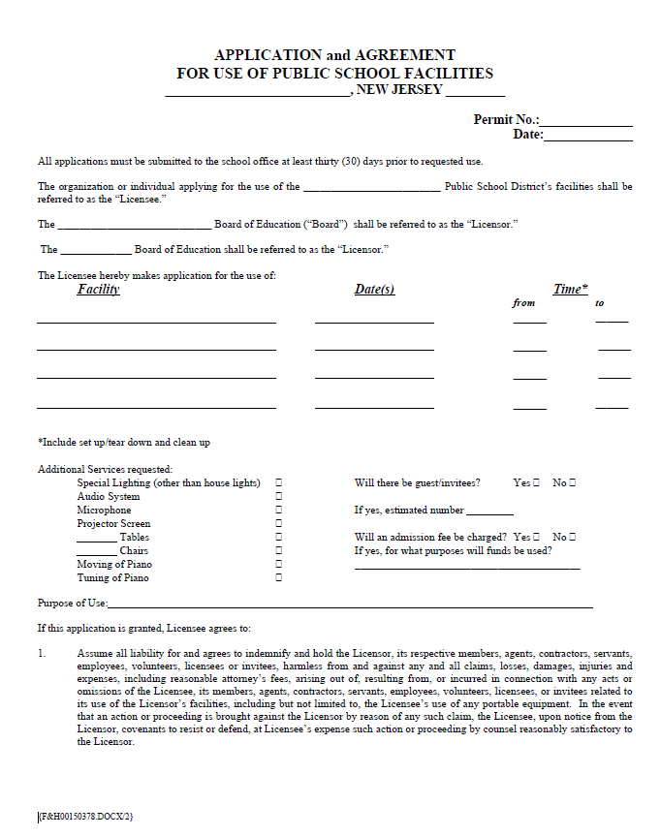
Use of Facilities Agreement
SAMPLE

Slide 71
ERRORS & OMISSIONS
(School Board Legal Liability)
NJSIG is moving the Errors & Omissions in-house
Report all known and potential claims by 6/30/2024

Slide 72
Evaluation & Certificate

Slide 73
THANK YOU!
ERIC West
Sub-fund Educational Meeting
ZOOM

