Slide 1
“Keeping Dollars in the Classrooms”
BACCEIC and ERIC South
Sub-fund Educational Luncheon
Thursday, May 16
11:00am - 1:00pm
Filomena Lakeview
Deptford, NJ

Slide 2
Al Kirk
Sub-fund Administrator
BACCEIC Sub-fund
ERIC South Sub-fund

Slide 3
PRESENTATIONS:
NJSIG’S EMPLOYMENT PRACTICES HOTLINE ATTORNEY (NEPHA)
Bruce Padula
Cleary Giacobbe Alfieri Jacobs, LLC
RETURN TO WORK / MODIFIED DUTY
Joanna Radomicki
NJSIG Member Services & Loss Control Representative
INDOOR AIR QUALITY
Matthew Genna
J.A. Montgomery Consulting

Slide 4
Jill Deitch, Esq.
Executive Director
NJSIG

Slide 5
NJSIG UPDATE
Vacant buildings policy changes
E&O to be brought in-house
Appraisals (85%)
Surplus
Safety Grant portal is open!
Underwriting Application Portal is live!

Slide 6
Joe Semptimphelter
Sr. Business Development Specialist
NJSIG

Slide 7
VALUE ADDED SERVICES
NJSIG New Marketing Materials

Slide 8
NJSIG UPDATES
SAFETY GRANT - CLOSING SOON!
Don’t forget to get your Safety Grant applications in!
Safety Grant Portal will close June 1st.
Contact:
JSemptimphelter@njsig.org
P: (609) 386-6060 x3044
UNDERWRITING APPLICATION - NOW OPEN!
the underwriting online application portal is now live! Please submit your applications asap!

Slide 9
Keeping Dollars in the Classroom: School Ethics, HIB, RIF
Bruce W. Padula, Esq.
Partner
CLEARY | GIACOBBE | ALFIERI | JACOBS

Slide 10
Introduction
The professional conduct of New Jersey School Board members is governed by the New Jersey School Ethics Act “Act,” N.J.S.A. 18A:12-24, et seq.
The Act is interpreted by The School Ethics Commission
In Advisory Opinions and Decisions

Slide 11
The New Jersey School Ethics Act
Mandates that members of boards of education avoid conduct which violates their public trust or which creates a justifiable impression that the public trust is being violated.
Identifies prohibited activities that would be conflicts of interest
Includes a code of ethics for school board members

Slide 12
School Official Ethics School Official Roles and Responsibilities
N.J.S.A. 18A:12-2 – Board Member Conflict of Interest Law
Nepotism Regulation – N.J.A.C. 6A:23A-6.2
School Ethics Act - N.J.S.A. 18A:12-21 et. seq.

Slide 13
School Official Ethics
Nepotism Regulation
School ethicS ACt
"Relative" – individual's spouse, civil union partner…domestic partner…, or the parent, child, sibling, aunt, uncle, niece, nephew, grandparent, grandchild, son-in-law, daughter-in-law, stepparent, stepchild, stepbrother, stepsister, half-brother or half-sister, of the individual or of the individual’s spouse, civil union partner or domestic partner, whether the relative is related to the individual or the individual’s spouse, civil union partner or domestic partner by blood, marriage or adoption.
"Relative“ - spouse, natural or adopted child, parent, or sibling of a school official

Slide 14
Code of Ethics for School Board Members N.J.S.A. 18A:12-24.1
Not surrender judgment to special interest or partisan political groups
Not use the schools for personal gain or gain of friends
Maintain confidentiality
Appoint most qualified personnel after consideration of recommendation of superintendent.
Support and protect school personnel in proper performance of their duties
Refer all complaints to the chief school administrator; act only after failure administrative solution

Slide 15
Common ISSUES
First Amendment
Social Media
Conflict of Interest
NJ Learning Standards and Curriculum Design
“Hot Topics,” i.e. Transgender Policies/Sexual Health and Physical Education/COVID-19

Slide 16
a) No school official or member of his immediate family shall have an interest in a business organization or engage in any business, transaction, or professional activity, which is in substantial conflict with the proper discharge of his duties in the public interest.
Advisory Opinion (A17-04). A board member would not violate N.J.S.A. 18 A:12-24(a) or (d) of the Act if he continued his employment with an architectural firm that is contracted by the Board, but he must recuse himself from all discussions, actions, resolutions and votes pertaining to the area of architecture pursuant to N.J.S.A. 18A:12-24(c). (July 26, 2004).
Albanese v. Kazan (C33-16). A board member did not violate N.J.S.A. 18A:12-24(a),(c), or (g) when she contributed towards a GoFundMe page in support of a full day kindergarten and was photographed with members of a Facebook group in support of the full day kindergarten. She participated in these activities in her individual capacity as a taxpaying citizen, as opposed to acting in her official capacity as a board member or representative of the board, and she did not receive any unwarranted privileges in exchange for her support. (November 1, 2017).

Slide 17
a) No school official or member of his immediate family shall have an interest in a business organization or engage in any business, transaction, or professional activity, which is in substantial conflict with the proper discharge of his duties in the public interest.
Advisory Opinion (A01-23). A board member sought advice as to whether, in connection with the employment with a food services vendor, they could continue to work in the district without violating the Act. Based on the facts and circumstances presented, the SEC advised that, because the board member is ultimately subject to supervision from senior leadership, including the superintendent and building principal(s), it would be a conflict of interest for the bard member to continue working in the district while also serving as a member of the board. Therefore, the SEC recommended that the board member ask their employer to be reassigned to another school district. The SEC additionally advised that, while employed by the food service vendor, the board member would need to recused themselves from discussions and votes concerning their employer, and regarding competing vendors or entities that offer the same (or similar) products or services as their employer).

Slide 18
b) Obtaining privileges, advantages, employment for self, family, others
Kearns v. Anthony (C18-01A). A board member was found to have used her official position to secure unwarranted privileges and advantages for herself and others, in violation of N.J.S.A. 18A:12-24(b), when she used her position as a board member to acquire mailing labels containing student information that were used to send mailings for a political campaign. The board member was censured. (October 23, 2001).
Holstein v. Raftopoulos-Johnson (C08-16). A Board member voted on a resolution that would result in her child attending Port Jervis School District, without payment of tuition, contravention of the Commissioner’s directive, and in violation of a send-receive agreement with High Point Regional School District. “Respondent used her position to secure an unwarranted privilege and/or advantage, namely “Board permitted” attendance at a school unauthorized by the Commissioner and free tuition for this unauthorized attendance.”

Slide 19
b) Obtaining privileges, advantages, employment for self, family, others (cont.).
Advisory Opinion (A03-23). A board member who was previously employed as an administrator and special education teacher in another school district, asked whether, because of their education and experience, they could serve on the local special education parent advisory group, and advocate for students and their families in the district. Per the SEC, the board member’s service in the district would be a conflict because the public could view their role as an advocate to be in substantial conflict with their duties and responsibilities as a board member; as a mechanism through which they could use or attempt to use their official position to secure unwarranted privileges or advantages for others; and as a service that might reasonably be expected to prejudice their independence of judgment in the exercise of their official duties as a board member. Further, in advocating for a district student or family, the board member could be doing so in opposition, whether directly or indirectly, to district staff and administration, and in opposition to the board itself. Nonetheless, the SEC encouraged the board member to provide such services outside the district.
Notes:
In the Matter of Sheila Brogan (C71-20). A Board member was found to have violated N.J.S.A. 18A:12-24(c), when she did not recuse herself from a May 7, 2021 executive session, where the Board discussed a lawsuit, which the Board member had a personal interest in and had reason to know would be discussed in the executive session. The Commission adopted the ALJ finding of fact, but rejected the ALJ’s legal conclusion that the Board member did not violate N.J.S.A. 18A:12-24(c). The Commission determined that case precedent required them to find that the Board member was in violation of the statute. The Commission reasoned, “[w]hen a school official has a conflict of interest of which the public is aware, and that school official goes behind closed doors when that item is discussed, the situation creates a justifiable impression among the public that their trust is being violated.” Page 6 (citing Lacey Township Board of Education, Docket No. C12-94, at 3). Additionally, the Commission pointed to public advisory opinion A33-95, which advised that a board member who has a conflict prohibiting him from negotiating would be in violation of the Act if he sat on the board’s closed session strategy discussions. This advisory opinion followed the Superior Court-Appellate Division’s ruling in Scotch Plains v. Syversten, 251 N.J. 566 (App. Div. 1991) (School board member who had litigation pending against the district could not attend executive sessions of the board discussing that litigation). Page 6. Furthermore, the Commission emphasized that the Board member was aware that the pending litigation would be discussed in the executive session.

Slide 20
b) Obtaining privileges, advantages, employment for self, family, others (cont.).
Advisory Opinion (A09-23). Board counsel inquired whether the superintendent and the board secretary/business administrator, who are in a personal relationship, have a conflict. The Commission states that they are regarded as “others” because they are not married, and that neither can provide the other with an unwarranted privilege, advantage, or employment. The SEC advised that the superintendent should not be involved in any aspect of the board secretary/business administrator’s evaluation or supervision.
Advisory Opinion (A10-23). Board counsel inquired whether a board member is prohibited from being involved in matters related to the superintendent when their child is employed as student employee in an afterschool care program, and is supervised by a district employee, who is ultimately supervised by the superintendent. The SEC advised that the board member has a conflict with respect to the immediate supervisor of their child, and to all other employees and administrators up the chain of command, including the superintendent. Because the board member’s child is supervised by a member of the local education association, the board member also had to recuse themselves from all matters related to the local education association.
Notes:
NEW

Slide 21
IMO Sheila Brogan, Appellate Division 6/21/23
Board member appealed from a 2/25/22 final decision of the School Ethics Commission, which found that she had violated the School Ethics Act, N.J.S.A. 18A:12-24(c), with a recommended penalty of censure. Before a Commissioner decision had issued, board member filed a notice of appeal with the Appellate Division, 3/9/22. Commissioner concurred with the censure penalty 4/14/22.
Appellate Division found that it lacked jurisdiction, as the appeal was not from a final judgment or final agency action and dismissed the appeal.
App. Div. considers appeals from final decisions or actions of state administrative agencies or officers and does not review administrative decisions when there is a further “right of review before any administrative agency or officer, unless the interest of justice requires otherwise.
Notes:
a public member could justifiably believe that their objectivity was impaired when voting upon and executing the settlement. a public member could justifiably believe that their objectivity was impaired when voting upon and executing the settlement.

Slide 22
Schwartz v. Abedrabbo, Awwad and Clifton BOE et. als, APP. DIV, October 6, 2023
Appeal of SEC complaint dismissal, 1/25/2022. Appellate Division affirms
SEC. Petitioner alleged that board members violated the School Ethics Act,
specifically N.J.S.A. 18A:12-24.1 (e) of the Code of Ethics of School Board
Members, when they made anti-Israel and allegedly anti-semitic remarks
during a virtual public board meeting. Majority of board members’ remarks
made during “Commissioner’s Comments” section of the meeting were
critical of Israel’s treatment of the Palestinians.

Slide 23
Siegel v. Aziz , Westfield Board of Education, Union County, C18-23 (December 19, 2023)
The complainant alleged that the respondent violated N.J.S.A. 18A:12-24.1(e) because she allegedly made repeated racist, antisemitic, and anti-Zionist public statements on her professional social media platform(s) and in an
academic publication and did so without using a disclaimer. In dismissing the complaint for failing to plead sufficient credible facts, the SEC stated, “Respondent’s statements, while controversial and likely perceived as offensive and hurtful to members of the district’s Jewish community as well as to the Jewish community as a whole, did not relate to the business of the
Board and/or its operations, nor was there a nexus between the social media page and/or academic publication to her Board membership.”
* Currently pending an appeal to Appellate Division.

Slide 24
EASY FIX
USE A DISCLAIMER

Slide 25
In a March 2019 decision, the SEC provided an indication of what an effective disclaimer could look like. In decision C64-18, the Commission reviewed an ethics complaint filed about social media posts. In the matter, a board member who was running for reelection was asked about why other candidates were blocked from participating in an online debate. The member responded that the blocking was related to harassment targeting her elementary school child. The complainant claimed that, in the context in which the response was made, the board member clearly identified the complainant’s child as the perpetrator of the alleged bullying, and asserted the comments were inaccurate and harmed the reputation of his child and spouse.
The SEC found that the social media comments were “clearly linked” to the member’s board membership and candidacy, and did not include a disclaimer such that it would have been reasonable for a member of the public to perceive that the statements were made in her board member capacity. In the decision, the SEC stated in a footnote:
A prominent disclaimer (caps/bold), such as, “the following statements are made in my capacity as a private citizen, and not in my capacity as a board member. These statements are also not representative of the board or its individual members, and solely represent my own personal opinions,” may have avoided the appearance — actual or perceived — that the statements were made in Respondent’s capacity as a Board member.

Slide 26
Pinto v. Cooper, Cusato, Parrino, Pedersen, et. al., Westwood Regional Board of Education Bergen County, C75-23
NJ Learning Standards and Curriculum – Board Ethics
Complainant alleged that Board member/Respondents provided inaccurate information regarding the NJ Learning Standards Health/Sex Education and the District’s curriculum
Respondents’ opinions not a violation of the Act
As long as not contrary to educational needs of ALL Children
Inclusive

Slide 27
SEC Complaint Dismissals 2021-23
SEC decided 29 complaints in 2021, 59 in 2022, 31 so far in 2023
Of the 29 complaints decided in 2021, 23 were dismissed;
Of the 59 complaints decided in 2022, 53 were dismissed.
Of the 47 complaints decided in 2023, 34 were dismissed.
In most instances of dismissal, Complainant failed to plead sufficient, credible facts to support a finding that Respondent violated a provision of the Code of Conduct or the Code of Ethics for School Board Members as alleged in the Complaint.
Only three complaints to date that have not been dismissed have not been adjudicated by the Commissioner of Education.
Fines for frivolous complaints – 2021 - $100; 2022 - $ 100, $500; 2023 - $100
School Ethics Commission Complaint Dismissals 2020 – 2023

Slide 28
OVERVIEW OF HARASSMENT, INTIMIDATION, BULLYING
1. Any gesture, written, verbal or physical act, including electronic communication
2. That is reasonably perceived as being motivated by an actual or perceived protected characteristic
3. Can be single incident or a series of incidents
4. Takes place on school property/school function; on school bus or off school grounds
5. Substantially disrupts classroom environment or harms student

Slide 29
HIB vs. Student Conflicts
Conduct that does not constitute HIB may nevertheless be a student conflict in violation of the Student Code of Conduct. Therefore, disciplinary action may still be appropriate.
Student Conflicts are not HIB
Conflict - disagreement, argument, fight or other action between people when they want different things, and everyone is equally involved.
During a conflict, name-calling, threats and other conduct that might look like bullying can occur. However, a conflict and bullying are very different. Unlike bullying, during a conflict people are equally involved in some type of disagreement. Conflict is considered mutual, meaning everyone is more or less evenly involved.
Bullying, by contrast, involves one-sided behavior, where one or more students are victims of unwanted or uninvited aggression that is reasonably believed to be motivated by a desire to physically and/or emotionally hurts the victim(s).
The behavior is not an attempt to positively or negatively address or resolve a problem.

Slide 30
Reporting and Investigating Allegations of HIB
N.J.S.A. 18A:37-15(b)(3)
Staff member or student relays incident to principal witnessed the incident or received reliable information
N.J.S.A. 18A: 37-15(b)(5)
Notifies parent(s) of HIB allegation and student(s) involved same day - Keep record of date, time, and manner of notification; also offer opportunity for counseling and other interventions

Slide 31
Reporting and Investigating
N.J.S.A. 18A: 37-15(b)(5)
Within two days of witnessing or learning of incident, the staff member who reported must provide the principal with a written report
Use confidential identifiers
Within (1) day of receiving verbal report, principal initiates HIB investigation with Anti-Bullying Specialist – N.J.S.A. 18A: 37-15(b)(6)(a)

Slide 32
Preliminary Determinations
Per N.J.S.A. 18A:17–46, if a school district’s policy permits a preliminary determination to be made on whether a reported incident or complaint is a report outside the scope of the definition of harassment, intimidation, or bullying pursuant to section 2 of P.L.2002, c. 83 (C.18A:37–14), the superintendent shall also provide annually to the board of education information on the number of times a preliminary determination was made that an incident or complaint was outside the scope of that definition for the purposes of the State’s monitoring of the school district.
The principal shall report to the superintendent if a preliminary determination is made under the school district’s policy that the reported incident or complaint is a report outside the scope of the definition of harassment, intimidation, or bullying, and the superintendent may require the principal to conduct an investigation of the incident, if the superintendent determines that an investigation is necessary because the incident is within the scope of the definition of harassment, intimidation, or bullying. The superintendent shall notify the principal of this determination in writing.
The NJDOE mandated form is also to be used even if a preliminary determination is made under the school district’s policy that the reported incident or complaint is a report outside the scope of the definition of harassment, intimidation, or bullying pursuant to section 2 of P.L.2002, c. 83 (C.18A:37–14). Similar to conduct investigated as HIB, the report shall be kept on file at the school but shall not be included in any student record, unless the incident results in disciplinary action or is otherwise required to be contained in a student’s record under State or federal law.

Slide 33
Investigation Tips
Complainant, Accused, and Witnesses will all be interviewed
Relevant documents, emails, and phone records will be requested
Information shared on a “Need to Know” basis
Complaints made in bad faith will be subject to discipline
School districts have the right to interview students without prior parent permission – Goss v. Lopez, 419 U.S. 595 (1975)

Slide 34
Preservation of Evidence
Collect any evidence of the incident that has been brought to your attention (written – i.e. text messages, notes, comments on social media, letters)
Physical items such as photos, videos, etc.
Make sure evidence is safe-guarded and entered into the record of the incident
Evidence preservation is important especially if there is an appeal of the decision

Slide 35
ALWAYS REMEMBER
Before an interview is concluded, ensure that the following has been asked and answered:
Who (did what; saw/heard what; was where; was affected; did you contact immediately after, if anyone)
What (happened; caused the incident; occurred before/after the incident; did you do right after the incident/comment)
Where (did the incident occur, where was the person at the time of the incident)
When (did the incident occur; when was the matter reported; when did the person learn of the incident)
Why (does the person think the conduct occurred; was the comment stated)
How (did the incident occur; how did the person learn of the incident; how did the you feel; how did you react after)

Slide 36
Investigation Report and Findings
A LITTLE EXPLANATION GOES A LONG WAY!
PREVENTS COSTLY MISTAKES

Slide 37
HIB Investigations
The HIB investigation must be completed within ten (10) school days from the date of the written report or from the date the Superintendent directs the principal to initiate an HIB investigation (following a preliminary determination). N.J.S.A. 18A:37-15(b)(6)(a).
The anti-bullying specialist may amend the report if there is additional information that was not available during the ten (10) school day period. N.J.S.A. 18A:37-15(b)(6)(a).
Within two (2) days of its completion, the results of the HIB investigation must be reported to the Superintendent. N.J.S.A. 18A:37-15(b)(6)(a)(b).
The Superintendent may decide to provide intervention services, establish training programs to reduce HIB and enhance school climate, impose discipline, order counseling, or take or recommend other appropriate action.
The Superintendent may also decide to seek further information.

Slide 38
Reporting Information to the Board & Parties
The Board of Education must be informed of the HIB investigation and results at the Board of Education meeting following completion of the HIB report. N.J.S.A. 18A:37-15(b)(6)(c).
Within five (5) days of informing the Board, the parents of the subject students and any accused staff member(s) must receive “information” in writing about the nature of the investigation and whether the District found evidence of HIB. N.J.S.A. 18A:37-15(b)(6)(d); N.J.A.C. 6A:16-7.7(a)(2)(xi).
The information should be sufficient for the parents/staff member(s) to understand why the alleged conduct did or did not constitute HIB. A summary of the investigation evidence should be referenced and a review of the applicable HIB criteria should be provided.
Remember FERPA and NJ Pupil Privacy Act restrictions!

Slide 39
HIB Hearings
After receiving the information, the parents and/or any accused staff member(s) may request a hearing before the Board of Education. N.J.S.A. 18A:37-15(b)(6)(d). The request for a hearing before the Board of Education must occur within 60 calendar days after receiving the written information about the investigation.
If requested, the hearing must occur within ten (10) days, and occur in closed, executive session. N.J.S.A. 18A:37-15(b)(6)(d).
Parents and any accused staff member(s) cannot be denied the opportunity to provide witnesses and appear before the Board of Education.
See Sadloch v. Cedar Grove Board of Education, OAL DKT. EDU 00619-14, decided March 25, 2015, adopted Commissioner Decision No. 216-15, June 23, 2015. (A failure to provide a staff member with an opportunity to be heard before the Board’s written determination may result in the expungement of the HIB record.)
Unreasonable time limitations may deprive parents and/or staff members with the due process that they are accorded under the law.
See Gibble v. Hunterdon Central Regional School District, OAL DKT EDU 02767-15, final decision (April 12, 2016) (parents were limited to 20 minutes and were precluded from presenting witnesses).

Slide 40
Resources from New Jersey Department of Education
HIB – Guidance for schools and parents, questions and answers on the ABR, HIB online tutorials, HIB model policy and guidance, and other HIB resources: http://www.state.nj.us/education/students/safety/behavior/hib/
School Climate and Culture – webinars, reports and other resources:
http://www.state.nj.us/education/students/safety/sandp/climate/

Slide 41
REDUCTIONS IN FORCE

Slide 42
Board Officers
A board secretary, assistant board secretary, school business administrator, or business manager of a BOE who serves for three consecutive years in that position holds his or her office under tenure, NJSA 18A:17-2a, provided the officer has devoted his or her full time to the duties of the office.
Walsh v. Laurel Springs BOE – board secretary who only worked full time a portion of the three years preceding her termination had not earned tenure

Slide 43
Secretaries and Clerks
A secretary or clerk holds his or her position under tenure after employment for three calendar years or three consecutive academic years together with employment at the beginning of the next successive academic year. N.J.S.A. 18A:17-2b.
Brenda Miller v. City of Newark

Slide 44
Tenure Rights
Tenure protects secretary/clerk from compensation decreases, even during RIF’s.
Custode v. Hackettstown Board of Education: A tenured secretary who was transferred to a lower-paying position in a RIF within her tenure could not have her salary reduced.
The tenure rights of secretaries and clerks are not to be transferred between different school districts due to these statues providing for teaching staff members as well.
Chinnis v. Lower Cape May Regional Board of Education: After working as a child study team secretary for three years under a de facto jointure commission, she was reassigned to a member district when the commission dissolved. However, her tenure did not carry over to the new position, making her subject to nonrenewal by her new employer.
Franklin Education Association v. Wallkill Valley Regional High School Board of Education: Secretaries were rehired in a new regional district following the discontinuation of their constituent district. The regional district was not obligated to acknowledge either their tenure status or their length of service.

Slide 45
Seniority
Staff members who are tenured are chosen for transfer or dismissal based on their seniority ranking. This ranking is conducted during their district service.
The State Board of Education at N.J.A.C. 6A:32-5.1 has established standards for determining seniority. These standards serve “a two-fold purpose: (1) to give a reasonable protection to professional staff members, and (2) to protect the school system by preventing seniority from operating in such a manner as to displace a qualified person with an unqualified one.”
Lautenschlager v. Jersey City Board of Education: In this case, a school district was responsible for determining the seniority status of five supervisors to then notify them of this status and place them on a preferred eligible list in order of seniority after getting rid of their positions.

Slide 46
When Seniority Applies
Seniority rights apply only in two circumstances
When a Reduction in Force occurs
When a vacancy occurs in the category of employment from which tenured teaching staff members were removed in a former RIF

Slide 47
Seniority
Mary McKennedy v. Board of Education of the Borough of Brielle, Monmouth County: The commissioner determined that even though a tenured teacher possessed a teacher of school studies endorsement (which she had never utilized), she could not assert seniority rights to a position occupied by a more senior tenured middle school teacher working under the same instructional endorsement, deemed highly qualified by the district in the subject area. According to the Commissioner, seniority rights are not inherently tied to one's highly qualified status, but rather to the duration of time during which the teacher actively taught the subject area (social studies) and the educational level (secondary) at which it was taught.

Slide 48
Creation of Categories
A teaching staff member earns seniority only within specific categories of employment.
N.J.S.A. 18:13-19
Categories do not necessarily align with tenure positions or with certification endorsements. Seniority categories and job titles need not conform; indeed, job title is less important than duties performed in the determination of seniority category.

Slide 49
Administrative
N.J.A.C. 6A:32-5.1(1) – categories do not precisely match the endorsements on the administrative certificate, any one of which may qualify employment in several seniority categories
Mirandi v. West Orange Board of Education: A recently laid off high school assistant principal was not entitled to an assistant principal position at a junior high school.
Schifano v. Jersey City Board of Education: The tenure of an elementary school principal could not be restricted to only the “primary” level.
Koch v. Fair Lawn Board of Education: Junior high school vice principal and high school vice principal are distinct seniority categories; there is not an overarching category for vice principals.

Slide 50
Limitation by endorsement
The instructional subject areas, along with their respective seniority classifications, are determined by the endorsements granted by the State Board of Examiners.
Tote v. Mercer County Vocational-Technical School Board of Education: Each distinct vocational endorsement constitutes an individual seniority classification; for instance, the skilled trades-automotive mechanics endorsement is distinct from the production, personal, or service occupation-service station attendant endorsement.
In re Seniority Rights of Certain Teaching Staff Members in Edison Township: Seniority for driver education teachers is determined by their driver education endorsements rather than physical education endorsements.
Hudson County Area Vo-Tech Education Association v. Hudson County Area Vo-Tech Board of Education: The seniority of a vocational teacher was confined to their specific production, personal, or service occupation endorsement and could not be expanded to encompass related PPSO endorsements.

Slide 51
Questions?
Bruce W. Padula, Esq. - CLEARY GIACOBBE ALFIERI JACOBS
955 NJ 34 Matawan, NJ 07747
bpadula@cgajlaw.com
(732) 583-7474

Slide 52
Joanna Radomicki
Member Services & Loss Control Representative
NJSIG

Slide 53
Return to Work
GETTING BACK TO WORK AFTER AN INJURY

Slide 54
Hi!
I’m Joanna Radomicki
Joined NJSIG in 2016. Spent the last 8 years as Senior Claims Representative for NJSIG’s Workers’ Compensation department.
01
02
April 2024, transitioned to NJSIG’s Member Services department as Member Services & Loss Control Representative.
03
Representative for ERIC North, MOCSSIF, and NJEIF sub-funds.
04
Email: JRadomicki@njsig.org
Phone: 609-386-6060 x 3029

Slide 55
Workers’ Compensation
Accidents Happen!
Regardless of how safe an employer may try to make the workplace, on-the-job accidents and job-related illnesses occur
Workers’ compensation benefits are mandated by law
Provide medical care and compensation to injured workers on a no-fault basis
Income protection for employees

Slide 56
NJSIG’s WC Process
Step 1
Claim is reported to NJSIG
Step 2
Assigned to NJSIG WC Claims Adjuster
Acknowledgment letter sent to the district’s WC Claims Contact
Step 3
NJSIG directs treatment
Step 4
NJSIG directs care to a medical provider with similar return to work philosophy
Step 5
Medical DR is required to update NJSIG within 48 hours following each medical visit
Step 6
Claims Adjuster/Nurse Case Manager will relay update with diagnosis and treatment place back to the WC Claims Contact
NJSIG strongly suggests encouraging the injured employee to update the district immediately after medical visits.

Slide 57
Shared Goal:
WC Claims Contact discusses accommodations with WC Adjuster:
Full duty
Out of work
Modified duty
Employees who cannot fulfill their contractual obligations of their current role are entitled to 100% lost wages and benefits for one year.
Districts are encouraged to bring injured employees back to work on modified duty.

Slide 58
Modified Duty
Once modified duty is determined:
The doctor has identified the capabilities of the injured employee.
Employees are placed in suitable positions that accommodate their physical limitations

Slide 59
Return to Work Benefits
Saves Money
Increases morale among
entire workforce
Enhances Recovery
Encourages teamwork
Increases self-esteem

Slide 60
Working in Partnership
Help us help you!
District should create a comprehensive modified duty/return to work policy tailored to the specific needs of the district and their employees.
Discuss strategies for return-to-work plans.
Plan and execute communication between HR, supervisors, and staff safeguarding employee’s abilities and limitations and encouraging collaboration.
Remain consistent and positive!

Slide 61
Establishing a
Return to Work Program
Objective
Eligibility
Communicate
Clearly outline the district’s position on modified duty
Restrictions will be reviewed (adherence with medical clearance and provide appropriate accommodations)
Can be discussed with:
NJSIG WC Adjuster
Legal Counsel
HR/Supervisor
Outline the rights and responsibilities of the employee during the return to work process
Included but not limited to; expectations, attendance, adherence, and special considerations

Slide 62
Defining Modified Duty
District personnel should be encouraged to make a list of tasks that can be included in the return to work program. These tasks should include a wish list of items that are often not complete due to more important, urgent, or pressing tasks.
The list can evolve over time.

Slide 63
Key Takeaways:
·Paying 100% wages for up to 1 year following accident.
·Establish a return to work program.
Return to work programs allow the district to benefit from new opportunities for task completion.
·Establish a return to work program.
·Commit to open lines of communication.
·Develop a modified duty task list in advance that can evolve over time.

Slide 64
Thank You!!
JOANNA RADOMICKI - NJSIG

Slide 65
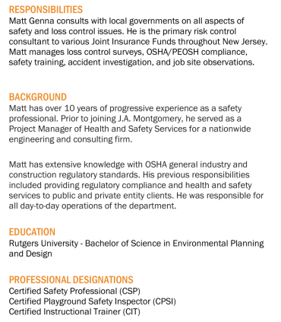

Slide 66
Resources/Regulatory Requirements/Indoor Air Quality
Presented by: J.A. Montgomery Consulting
Download the MEL App
Search ‘nj mel’ in your app store

Slide 67
Introduction
Matt Genna, Assistant Director – J.A. Montgomery Consulting
MSI resources available to your organization
Relevant regulatory requirements
NJ Indoor Air Quality requirements

Slide 68
Resources
MEL Safety Institute (MSI)
MSI Training
MSI Bulletins
MSI Model Policies
MSI Briefings

Slide 69
MSI Catalog

Slide 70
MSI LIVE
MSI LIVE features real-time, instructor-led classes.
The MSI LIVE Catalog provides a description of the course, the intended audience, and available credits.

Slide 71
MSI LIVE
Schools: Chemical Lab Safety for Science Teachers
Schools: Safety Awareness Training for School Custodians and Facilities Management

Slide 72
MSI NOW
MSI NOW provides on-demand streaming videos and online classes that can be viewed 24/7 by our members.
Topics pertain to many aspects of safety, risk control, employment practices, and supervision and most can be viewed in under 20 minutes.

Slide 73
MSI Bulletins
Cold Weather Best Practices for Buildings
Dealing with Service Dogs
Fire Extinguisher Best Practices
Space Heater Safety
Playground Risk Management
Youth Coaches Best Practices

Slide 74
MSI Briefings
Toolbox Talks
Organized by Season and job type
Video Briefing
Responsibilities of a RTK Coordinator
Fire Extinguisher Inspection
Safety Committee Best Practices

Slide 75
MSI Model Policies
Chemical Hygiene
Confined Spaces
Control of Hazardous Energy (Lockout/Tagout)
Hazard Communication
Emergency Action Plan
PPE
And more…

Slide 76
Regulatory

Slide 77
Elements of a Safety Program
Support from upper management
Regulatory written programs
Facility inspections
Safety training
Job Safety Observations (JSO)
Safety Committees
Accident / injury investigations

Slide 78
Regulations - OSHA
With the Occupational Safety and Health Act of 1970, Congress created the Occupational Safety and Health Administration (OSHA)
OSHA’s purpose is to ensure safe and healthful working conditions
Sets and enforces standards
Provides training, outreach, education and assistance

Slide 79
Regulations – NJ PEOSH
Public Employees Occupational Safety and Health (PEOSH) develops and enforces occupational health standards for public employees in New Jersey
Encourages employers and employees to improve their working environment
Will enforce OSHA Regulations

Slide 80
PEOSH Inspection
Inspections can be:
Programmed inspection
Complaint response
Injury/fatality investigation
Consultation

Slide 81
During PEOSH Inspection
Complaint and Programmed Inspections WILL BE unannounced & during business hours
Except when:
An imminent danger
Can only effectively be conducted after hours
To ensure someone is present at facility
PEOSH Inspectors:
Have the right to privately interview employees
Have the right to question employees

Slide 82
Inspection Process
Inspector identification & credentialing
Opening Conference
Escorted Walk-around
Closing Conference
Inspector will announce themself and show credentials to a manager.
You may deny entry, but they may return with a warrant.

Slide 83
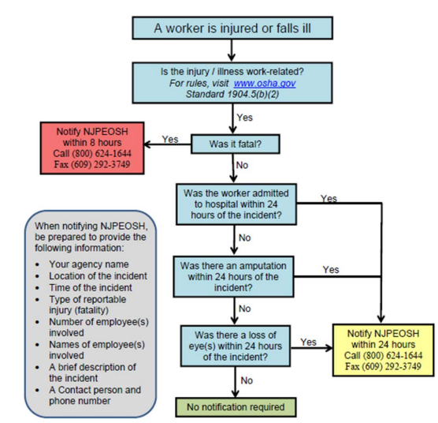
Reporting Injuries/Illnesses
Notes:
New Jersey Public Employers must report fatalities to NJPEOSH within eight (8) hours of the occurrence and report work-related hospitalizations, amputations, or loss of an eye within 24 hours by calling the 24-hour hotline (800)624-1644 or the 24-hour fax line (609)292-3749.

Slide 84
Annual Reporting
Recordkeeping –NJOSH 300 Forms 1904.29(a)
Must record info about every work-related death and work-related injury or illness involving:
Loss of consciousness
Restricted work activity/job transfer
Days away from work
Medical treatment beyond first aid
Significant injuries/illnesses diagnosed by physician or LHCP.

Slide 85
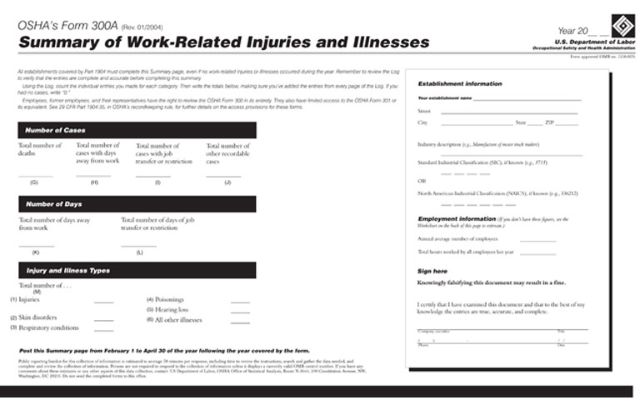
Annual Reporting
Complete Summary of Work-Related Injuries and Illnesses
Post the Summary page from February 1 to April 30 of the year following the year covered by the form

Slide 86
Employers Must Protect Employees by Providing
Engineering Controls
Work Practice Controls
Personal Protective Equipment
Eliminate process
Substitute safer process
Redesign process
To the extent ‘feasible’
Safer policies
Safer practices
Training
To the extent ‘feasible’
LAST RESORT
PPE does not remove hazard
Training critical
Selection
Limitations
Notes:
Explain that they will see this concept in many of the topics we will be discussing. Hazcom, bbp, ppe, etc.

Slide 87
Regulatory Requirements
Hazard Communication
& Right-To-Know

Slide 88
Employer’s Obligations & Worker Rights
Employers must:
Inventory chemicals
Maintain chemical data sheets
Evaluate chemical hazards & institute safeguards
Display RTK poster
Develop a written program
Submit RTK survey (July 15th)

Slide 89
Employer’s Obligations & Worker Rights
Employers must
Educate and train workers
Right to understand chemical hazards & safeguards
Right to file complaint
Right to medical records

Slide 90
Regulatory Requirements
Bloodborne Pathogens

Slide 91
Tasks with Potential Occupational Exposures
Cleaning restrooms & playgrounds
Handling solid waste
Cleaning apartments after accidents

Slide 92
Employer Requirements
Exposure Control Plan
Training
Hepatitis B Vaccine
Engineering, Administrative and Personal Protective Equipment controls
Model Exposure Control Plans

Slide 93
Regulatory Requirements
Personal Protective Equipment (PPE)

Slide 94
Complete Job Hazard Assessment
Must be in writing
Who, when & where
Certified (signed)
For all job tasks
Identify the hazards
Identify control measures or safeguards
Notes:
These are many different forms to help identify where hazards exist. This is one of the forms used by JA Montgomery.

Slide 95
Regulatory Requirements
Asbestos, Lead & Silica

Slide 96
Buildings Built Before 1978 & 1980
Up to 1978: Lead paint & solder
Up to 1980: Asbestos
Silica-containing materials are still used extensively

Slide 97
Employers Must Communicate Hazard
Must presume thermal insulating materials are ACM (in pre-1980 buildings), until analyzed.
Must presume asphalt & vinyl floor materials are ACM (in pre-1980 buildings), until analyzed.
Employers must train workers who may come in contact with ACM or Presumed Asbestos Containing Materials (PACM).
Inform contractors of ACM & PACM.
Maintain records of presence and tests of ACM & PACM.
Notes:
Certain materials must be PRESUMED to contain asbestos, until material analyzed and shown NOT to contain asbestos fire

Slide 98
Asbestos Training for Employees
The employer shall provide asbestos awareness training to employees who perform housekeeping work in areas where ACM and/or PACM is present.
Each such employee shall be so trained at least once a year.
Training includes:
Health effects of asbestos
Locations of ACM and PACM in the building/facility
Recognition of ACM and PACM damage
Proper response to fiber release episodes
Notes:
1910.1001(j)(7)(iv)The employer shall also provide, at no cost to employees who perform housekeeping operations in an area which contains ACM or PACM, an asbestos awareness training course, which shall at a minimum contain the following elements: health effects of asbestos, locations of ACM and PACM in the building/facility, recognition of ACM and PACM damage and deterioration, requirements in this standard relating to housekeeping, and proper response to fiber release episodes, to all employees who perform housekeeping work in areas where ACM and/or PACM is present. Each such employee shall be so trained at least once a year.

Slide 99
Tasks with Potential Silica Exposure
Activities
Sawing
Chipping
Drilling
Grinding
Crushing
Polishing
Clean-up
Sand blasting
Materials
Asphalt
Brick
Concrete & mortar
Granite
Joint compound
Pavers & blocks
Terrazzo
Tile & grout
Notes:
Obviously, most PW (Road Dept.), Facilities (Buildings & Grounds) and Utility workers do at least some of these tasks. So this section is for YOU.

Slide 100
Working with Lead-based Paint
Assume pre-1978 paint contains lead
Avoid creating or spreading dust & fumes
Use low dust practices
Avoid sanding, scraping, & burning
Use respiratory protection
Protect occupants & workers
Wash hands often
Do not eat, drink, or smoke when working with lead
Avoid taking dust home
Clean-up properly

Slide 101
Removing Lead-based Paint
Do not use high speed sanders or grinders
Unless with HEPA vacuum
Do not use open flame or heat gun or HIGH setting
Creates toxic fumes
Do not use uncontained abrasive blasting
Avoid excessive dry scraping or sanding

Slide 102
Reporting Hazardous Conditions
Have a system in place for employees to report:
Trip and fall hazards
Fire hazards
Blocked exits
Storage in stairwells
Loose handrails
Damaged steps
ANY HAZARDOUS CONDITION

Slide 103
Indoor Air Quality

Slide 104
PEOSH IAQ Standard N.J.A.C. 12:100-13 et seq.
Adopted in 1998
First IAQ Standard in U.S.
Revised in 2007, PEOSH Advisory Board, IAQ Subcommittee
Effective date: May 21, 2007

Slide 105
Skills and Authority of Designated Person
Knowledgeable about NJ IAQ Standard
Familiar with basic issues regarding IAQ
Working knowledge of air handling systems
Be in a position of authority
Notes:
Examples: Head of Maintenance, H&S professional, B&G Director. Lower level personnel may not have adequate authority. Can be a consultant. Admin must contact consultant.

Slide 106
Skills and Authority of Designated Person
Effectively communicate with management, staff, maintenance, and contractors
Good problem solver
Be available
Notes:
Examples: Head of Maintenance, H&S professional, B&G Director. Lower level personnel may not have adequate authority. Can be a consultant. Admin must contact consultant.

Slide 107
Role of the Designated Person
Coordinate IAQ Activities
Prepare Written IAQ Program
Establish and follow preventive maintenance procedures
Track unscheduled maintenance
Establish control measures for pollutants
Renovation and construction, and maintenance
Specific facility operations
Recordkeeping
Annual Written IAQ Program Review
Notes:
The primary role for the Designated Person is to serve as point person for coordinating the activities of monitoring and assessing employee activities and any workplace processes that may affect the quality of the indoor environment. The Designated Person may function only as the coordinator of events and activities, or may be responsible for both coordinating and implementing mitigating activities to solve IAQ problems. The type, size, and complexity of the facility and its air handling system, and the expertise of the Designated Person will determine his/her specific role.

Slide 108
Management of IAQ A Coordinated Effort
Employee
PEOSH
Employer
Remediation
Contractor
Property
Manager
Desig.
Person
GC
Maint.
IAQ
Consult
HVAC
Cont.
Notes:
Situations can be complex.

Slide 109
IAQ Basics
Problems occur in many types of buildings
Problems reflect both comfort and health related issues
Primary sources of IAQ problems include:
Ventilation
Contaminants generated indoors
Infiltration of outdoor contaminants
Unidentified sources
Notes:
Problems occur in new and old buildings. Off gassing of materials in new. Malfunctioning systems in older.
Comfort issues (temp), health issues (respiratory symptoms)
Inadequately ventilated storage closets.
Outdoor contaminants: natural and man-made

Slide 110
Acceptable IAQ
ASHRAE defines acceptable IAQ as:
“air in which there are no known contaminants at harmful concentrations, as determined by authorities and at which a substantial majority (80% or more) of the people exposed do not express dissatisfaction”
Notes:
Even within recommended standards, still have 20% complaint rate.
American Society of Heating, Refrigeration, and Air-Conditioning Engineers (ASHRAE)

Slide 111
IAQ Basics – Health Effects
Varied and non-specific
Reports of health-related problems and comfort issues
Air monitoring does not always support their existence
Notes:
Difficult to assess and associate with building. Drs frequently diagnose symptoms as “building related” based on limited anecdotal information. There could be other causes (allergy season, infectious disease).

Slide 112
Sick Building Syndrome (SBS) vs. Building-Related Illness (BRI)
SBS Symptoms:
Do not fit the pattern of any particular illness
Difficult to trace to a specific source
Relief occurs upon leaving the building
BRI Symptoms:
Are often accompanied by physical signs identified by a physician and/or laboratory findings
Relief from illness may not occur upon leaving the building
Notes:
SBS is general. Difficult to diagnose and treat.
BRI is more concrete and defined

Slide 113
Sick Building Syndrome (SBS) vs. Building-Related Illness (BRI)
SBS
Headaches
Eye, nose, throat irritation
Dry or itchy skin
Fatigue
Dizziness
Nausea
Loss of concentration
BRI
Eye, nose, throat, and upper respiratory tract irritation
Skin irritation or rashes
Chills, fever, cough, chest tightness, congestion, sneezing, runny nose
Muscle aches
Notes:
Similar symptoms. BRI is more defined and treatable.

Slide 114
Building-Related Illnesses
Hypersensitivity Pneumonitis
Asthma
Chemical Sensitivity
Legionnaires’ Disease

Slide 115
IAQ Basics
Factors Affecting IAQ:
Activities of building occupants
Design and condition of HVAC
Construction and renovation activities
General outdoor sources
Notes:
Activities: Perfume, plants, air fresheners, candles, etc.
Design and Condition: New vs. old, add-ons
General Outdoor: pollen, mold, leaves, diesel exhaust.

Slide 116
IAQ Ventilation System
Heating Ventilation and Air Conditioning (HVAC)
Purpose
Regulates the temperature and humidity for comfort
Supplies general ventilation to decrease indoor pollutants
Notes:
In general ventilation systems regulate temperature and humidity for the comfort of building occupants. It also supplies general ventilation which decreases common indoor contaminants. The type and purpose of the HVAC system will determine the exact components found in a facility’s system.

Slide 117
PEOSH IAQ Standard N.J.A.C. 12:100-13 et seq.
13.1 Scope
13.2 Definitions
13.3 Compliance Program
13.4 Control of Specific Contaminant Sources
13.5 Air Quality During Renovation & Remodeling
13.6 Recordkeeping
13.7 Employer’s Response to Complaints
13.8 IAQ Compliance Documents

Slide 118
PEOSH IAQ Standard N.J.A.C. 12:100-13.2
Definitions:
"Office building" means a building in which administrative, clerical or educational activities are conducted. Examples of facilities and/or operations, which are not office buildings, include repair shops, garages, print shops and warehouses.
Notes:
Selected Definitions
Office Building: Office-type work
HVAC: Includes all components. Includes window A/C units.
Renovation: Building modification, not repair

Slide 119
PEOSH IAQ Standard N.J.A.C. 12:100-13.2
Definitions:
"Renovation and remodeling" means building modification involving activities that include but are not limited to: removal or replacement of walls, roofing, ceilings, floors, carpet, and components such as moldings, cabinets, doors, and windows; painting; decorating; demolition; surface refinishing; and removal or cleaning of ventilation ducts.

Slide 120
PEOSH IAQ Standard N.J.A.C. 12:100-13.3
Employer shall identify and train a Designated Person
Employer’s designated person shall:
Establish and follow a preventative maintenance schedule
Ensure that damaged or inoperable components are replaced or repaired promptly, ensure no microbial growth

Slide 121
PEOSH IAQ Standard N.J.A.C. 12:100-13.3
Employer’s designated person shall:
Implement the use of general or local exhaust ventilation
Check the HVAC system when carbon dioxide levels exceed 1,000 ppm
Check HVAC system if temperature range is outside 68°F-79°F
Prevent contamination of fresh air supply

Slide 122
PEOSH IAQ Standard N.J.A.C. 12:100-13.3
Employer’s designated person shall:
Check natural ventilation portals are maintained
Promptly investigate all employee complaints about BRI or SBS
Prepare written plan (including required components)
Review and update written plan annually
Notes:
Stress Temperature requirement
Model written plan is provided by PEOSH\
Maintain in operable condition all portals designed for introducing natural ventilation
windows, doors, vents, and stacks

Slide 123
Control Indoor Contaminants
Microbial Contaminants
Promptly repair water intrusion that can promote growth of biologicals
Remediate damp/wet material by drying or removal within 48hrs of discovery and continue until water intrusion is eliminated
Remove visible microbial contamination
Notes:
Are not required to fix leak w/in 48hrs, just remove material.
Clean up mold in accordance with recommended practice. Don’t have to sample. Spend money on repair.

Slide 124
Renovation & Remodeling
Evaluate chemical hazards
Notify employees 24 hours prior to any construction
Utilize local exhaust ventilation
Isolate construction areas (scheduling, physical barriers, pressure differentials)
Construction areas required to be cleaned and aired out as necessary prior to re-occupancy
Notes:
Example notification form included in program
Cleaned and aired out is subjective. No visible dust or offensive odors. Temp relocate sensitive staff may be advisable.

Slide 125
Recordkeeping
Required Records
Written IAQ Program
Documentation of Designated Person Training
Written Preventive Maintenance Program
Preventive Maintenance Log
Notes:
and Blueprints, water treatment logs, HVAC commissioning reports, balancing reports, O&M manuals.

Slide 126
Recordkeeping
Requirements:
Maintained for 3 years
Available to employees and representatives for examination and copying ASAP or within 10 working days
Available immediately during PEOSH inspection
Notes:
10 day deadline is new

Slide 127
Employer Response to Complaint
Response (w/in 15 working days) may include any of the following:
Complaint unfounded;
Description and documentation of remedial action taken;
An outline of remedial measures planned with a timetable for completion; and/or
A statement that the problem is being studied with a timetable for completion of the study
Notes:
Response (w/in 15 working days) may include any of the following:
Complaint unfounded;
Description and documentation of remedial action taken;
An outline of remedial measures planned with a timetable for completion; and/or
A statement that the problem is being studied with a timetable for completion of the study

Slide 128
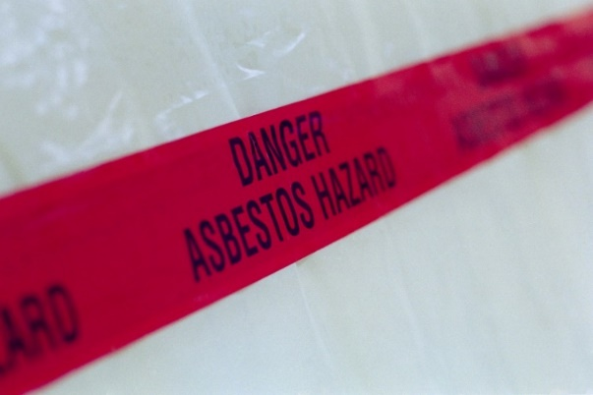
Other Standards Related to IAQ (Overview)
PEOSH General Industry and Construction Asbestos Standards
Identification of asbestos-containing materials in all buildings (pre-1980)
Labeling and signage requirements
Annual awareness training
Notification of outside contractors
Notes:
PEOSH General Industry (29 CFR 1910.1001)
Construction (29 CFR 1926.1101) Asbestos Standards

Slide 129
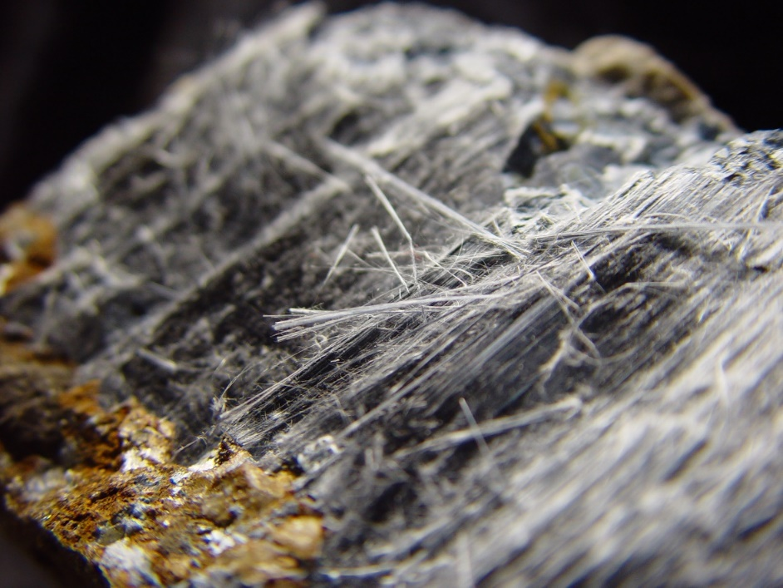
Other Standards Related to IAQ (Overview)
Other Federal and State Asbestos Standards
Schools (AHERA)-U.S. EPA/NJDHSS
NJ Uniform Construction Code-Subchapter 8, NJ Dept. of Community Affairs (NJDCA)

Slide 130
Other Standards Related to IAQ (Overview)
Air Contaminants Standard (29 CFR 1910.1000, Tables Z-1, Z-2)
Access to Employee Exposure and Medical Records Standard (29 CFR 1910.1020)

Slide 131
PEOSH Program Response to Unacceptable IAQ
Conduct Employee Interviews
Review Building Operations & Maintenance Procedures
Walk-through Inspection
Inspect HVAC System
Review As-Builts
Conduct Sampling, if necessary
Complete PEOSH IAQ Checklist

Slide 132
IAQ Preventive Maintenance (PM)
Equipment List
Master Schedule
Documentation
Notes:
Equipment List
Equipment List, Inventory
Operating Manuals, ASHRAE Guidelines
Control blueprints
Master Schedule
Scheduled maintenance tasks, Mfgr. Recs.
Work orders, Maintenance Contracts
Documentation
Inspection/Maintenance checklists
Documentation of unscheduled repairs

Slide 133
IAQ Employee Complaints
Follow Up on Employees Complaints
Conduct interviews
Review building operations and maintenance procedures
Complete PEOSH IAQ Inspection Checklist
Involve employees through L/MH&SC
Communicate outcome and corrective action
Report all complaints to one person
Notes:
Using the employee diary form will give insight to any patterns developing with respect to symptoms, area of concern and exposure route.
Complaints should be reported to one person so that they can be accurately evaluated and assessed and problem areas identified.
*Labor-Management Health & Safety Committee

Slide 134
Ask for Help
PEOSH Health Consultation Project
Local/County Health Departments
Private Consultants
American Industrial Hygiene Association (AIHA) - www.aiha.org

Slide 135
Questions?

Slide 136
THANK YOU!
BACCEIC and ERIC South
Sub-fund Educational Luncheon

