Slide 1

Law, Ethics and Governance for All Leaders, including an Overview of New and Emerging Issues
AJG/Alliant/LEGAL ONE:
Monday Madness Series
Never Crossing the Line! Understanding and Enforcing Student and Staff Boundaries
August 12, 2024

Slide 2
Presenters
David Nash, Esq., Director of Legal Education and National Outreach
Rebecca Gold, LEGAL ONE Consultant
Dr. Rosetta Treece, Superintendent - Hopewell Valley Regional School District
Dr. Charles Ford, Superintendent – Monmouth County Vocational School District

Slide 3
Great Partnership
LEGAL ONE partnership with Arthur J. Gallagher, Alliant, New Jersey Schools Insurance Group
Upcoming training and podcasts
School Law Central

Slide 4
Upcoming Monday Madness Sessions
FREE Sessions
August 19 - Is Your Staff Ready for the New School Year? Implementing Sound HR Protocols - Registration
September 16 - Bullying, Discrimination Law and Public Schools: Navigating an Ever Changing Legal Landscape - Registration
September 30 - The Role of Schools: Understanding the Parameters of Political Speech for Staff and Students in Crazy Times! - Registration

Slide 5
Upcoming Podcast Episodes
The LEGAL ONE Podcast - https://www.thelegalonepodcast.com/
Schools and Athletics (Alliant)
  August 19 - Addressing Student Athlete Mental Health
  August 26 - New Rules for Student Athlete Clearance
  September 2 – The New Title IX
Schools and Human Resources (Arthur J. Gallagher)
  September 16 – October 4

Slide 6
DISCLAIMER
This presentation is intended as a summary of law only and is not meant as legal advice. Please consult your attorney to obtain legal advice.
Participants are authorized to use the LEGAL ONE materials provided in this training to offer turnkey training within the respective participant's school district or place of employment, provided that participants provide proper credit to LEGAL ONE for having developed said materials and further provided that such turnkey training is offered at no charge.

Slide 7
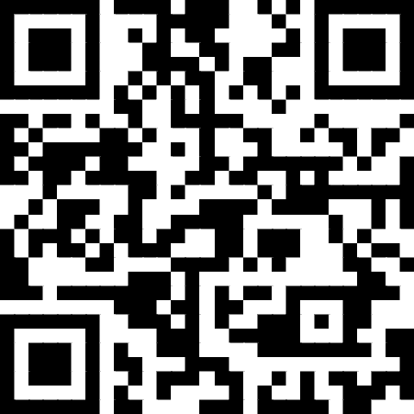
Presentation Materials
Today’s document(s) can be accessed at
https://tinyurl.com/LO-AJG-240812
This folder can be accessed for 30 days from the session date.
Please download all files before the link expires.

Slide 8
Today’s Topics
Why This Matters
Scenarios
Types of Relationships
Types of Boundaries
Being Proactive
Applicable Laws
Conducting Investigations
Addressing Concerning Behaviors
What’s Next?

Slide 9
Why this matters

Slide 10


Child sexual abuse statistics
1 in 10 children are estimated to be victims of sexual abuse today.
1 in 4 girls and 1 in 20 boys self-report having experienced sexual abuse.
Over a third of sexual abuse is committed by family members; 60% by other known and trusted adults.
The Enough Abuse Campaign

Slide 11
Staff Member Safety
See the report Violence and Aggression Against Educators and School Personnel
Rates of intentions to quit the profession ranged from 21% to 43% during COVID-19 restrictions (2020–2021) and from 23% to 57% after COVID-19 restrictions (2021–2022), varying by stakeholder role.
Participants across roles reported substantial rates of anxiety and stress, especially during and after COVID-19 restrictions, and identified specific training needs. Implications for theory, research, training, and policy are presented.

Slide 12
scenarios

Slide 13
What If …
Coach wants to reach out to individual athlete who is recovering from injury. He is worried about the student’s mental health.
Teacher wants to attend a political rally and bring a sign to the rally. He then wants to discuss the rally in class with his students the next day.
An administrator is interested in dating a staff member he supervises. They have been friends for many years, going back to when they were both in college.
A recent student graduate reaches out and wishes to friend a former teacher on social media
A student reveals to you that he is transgender but asks you not to tell their parents. The student asks if they can text you outside of school if they need to talk.

Slide 14
6. Addressing Mr. Gossip
It is Friday morning and you are looking forward to the weekend. You come into work and are immediately told by one of your co-workers that another co-worker, Mr. Gossip, made disparaging remarks about you in the staff lounge yesterday when you were home sick. It was a Monday and the rumor is that Mr. Gossip joked that you are always “conveniently sick” around a weekend and have been diagnosed with “full week-itis.” It is the 3rd time you have been absent this year. 2 were on Mondays and 1 on a Friday.
What do you do now?

Slide 15
7. Politics in the Workplace
A staff member comes in on Monday morning and says “did you see that joke of a debate last night. They’re all morons and anyone who votes for one of those clowns is a moron too.”
You saw the debate and like one of the candidates. You respond, “I liked one of the candidates. Are you calling me a moron?”
What now? How might this escalate? How could it have been handled differently?

Slide 16
Types of relationships

Slide 17
Staff/Student
In-Class
Unique Student Needs
Athletics/Extracurricular Activities
Counseling
Student Discipline/Investigations
Less Structured Settings
  Hallways, playgrounds, school bus, before or after school
Field Trips
Relative or Neighbor
Chance Meetings outside of school
Social Media/Electronic Communications

Slide 18
Student/Student
Same School
Different School/Different District
Classmates
Friends
Teammates
Dating
Ongoing Conflict/History
Power Imbalance
Developmental Level/Disability
Multilingual Learner

Slide 19
Staff/Staff
Colleagues
Supervisor/Subordinate
Friends
Dating
Ongoing Conflict/History
New to School/District
Experienced v. Inexperienced
Vendors providing services otherwise offered by school employees

Slide 20
Types of boundaries

Slide 21
Physical Boundaries
Touching
Physical Proximity
Sound
Smell (e.g. allergies)
Visual
Sensory Limits/Overload
Prior History/Trauma
Closed Doors
Transporting

Slide 22
Virtual Boundaries
Social Media
  Privacy Settings
  Identification with School/District
Electronic Communications
  Push Out v. Two-Way
  Transparency, Consent
Artificial Intelligence
  Sharing Personally Identifiable Data
  Using image, voice, video without permission
  Creating new image, voice, video that appears authentic

Slide 23
Emotional/Intimacy Boundaries
Sharing Personal History/Interests/Trauma
Asking others to share personal history/interests/trauma
Expressions of caring, support, love, anger, hate
Pursuing deeper emotional/intimacy connections

Slide 24
Being proACTIVE

Slide 25
Key Question
  Would I be doing this if the student’s family or my colleagues were standing next to me?

Slide 26

HVRSD Staff and Student Interaction Guidelines
See R3281/4281 Inappropriate Support/Teaching Staff Conduct
See HVRSD Staff and Student Interaction Guidelines
Creating school-wide culture - students and staff understand responsibility to report without fearing retaliation
General rule: when meeting alone, meet in public or visible place
Avoid situations which could prompt suspicion.
26

Slide 27

Boundaries – Unacceptable Behaviors:
Violation of District policies:
Giving gifts – personal, intimate nature
Unnecessary physical contact
Being alone off campus without permission
Making sexual comments, jokes, stories, etc.
Seeking emotional involvement for employee’s benefit
Being alone in a car with one child; giving student a ride to or from school activities
27

Slide 28

Boundaries – Unacceptable Behaviors:
Being alone at school with door and window blinds closed
Inappropriate use of social media
Excessive attention to one student
Personal communications not related to school
Failing to keep admin informed with issues involving student welfare
Using profanity or inappropriate language
28

Slide 29

Regulations
Definitions
Reporting Procedures – Boundaries or Suspected Abuse
Investigations – Preliminary and Full
29

Slide 30
Special Needs Children
Staff members who work with special needs and/or very young students are often required to use various forms of physical guidance and prompting with a student in order to teacher them and/or help them perform specific tasks such as self-care and self-help responses, academic tasks, social skills, gross and fine motor skills.

Slide 31
Special Needs Children (cont’d)
These staff members are trained to provide physical prompting as part of evidence-based procedures for teaching skills to acquisition.
The use of these prompts is expected to decrease over time as students gain a greater sense of independence.

Slide 32
Young Children
Age, development and context should be understood in terms of when or how physical contact may or may not be appropriate. For example, with very young children, physical contact in the form of
  hugs,
  pats on the back or shoulder, and
  holding hands while walking are common and appropriate interactions.
Such interactions are not appropriate with developmentally older students and should not occur.

Slide 33
Other Examples of
Appropriate Contact
Skill development in areas such as:
  Sports
  Instrumental Music
  Art
  Dance

Slide 34
Social Relationships
“Inappropriate conduct” includes … a request by a school staff member to a student to enter into a social relationship outside the school staff/student relationship.

Slide 35
Applicable law/policies

Slide 36
Student Information/Interactions
FERPA
HIPAA
Anti-Bullying Bill of Rights
Dating Violence Law
Title IX
NJ Law Against Discrimination/Other Anti-Discrimination Laws
Code of Student Conduct/Board Policies
Curriculum
Constitutional/Statutory Due Process Protections

Slide 37
Staff Interactions/Information
Open Public Records Act
Open Public Meetings Act
PERC Law/Collective Bargaining Agreement
Affirmative Action/Anti-Discrimination Law
Healthy Workplace Environment
TEACHNJ
Progressive Supervision
Staff Professional Development

Slide 38
Professional Development
Child Abuse/Neglect
Discrimination Law
HIB
Student Substance Use
Special Education
Multilingual Learners
SEL
Mandated Reports to Law Enforcement

Slide 39
Sample Health Workplace Environment Policy
The Board of Education recognizes a healthy workplace environment enables school support staff members to fully contribute their expertise and skills to their school district responsibilities. A healthy workplace environment can improve productivity, reduce absenteeism, and reduce staff turnover while having a positive impact on the school district’s programs provided to pupils in the school district.
A significant characteristic of a healthy workplace environment is that employees interact with each other with dignity and respect regardless of an employee’s work assignment or position in the school district. Repeated malicious conduct of an employee or group of employees directed toward another employee or group of employees in the workplace that a reasonable person would find hostile or offensive is unacceptable and is not conducive to establishing or maintaining a healthy workplace environment.

Slide 40
HWE Policy (cont’d)
This unacceptable conduct may include, but is not limited to, repeated infliction of:
  verbal abuse such as the use of derogatory remarks; insults; verbal or physical conduct that a reasonable person would find threatening, intimidating, or humiliating;
  or the gratuitous sabotage or undermining of a person’s work performance.
  A single act of such conduct shall not constitute the unacceptable conduct prohibited by this policy unless it is especially severe and egregious.

Slide 41
HWE Policy (cont’d)
Unacceptable conduct, for the purposes of this policy, is not conduct toward an employee of a protected class or because of the employee’s protected activity. These employees and activities are afforded the legal protections under various Federal and State anti-discrimination laws.
In addition, unacceptable conduct for the purposes of this policy shall not be confused with conduct of management employees exercising management rights including, but not limited to, assigning tasks, reprimanding, assigning discipline, or directing.

Slide 42
Hostile Work Environment
Severe or pervasive conduct that causes harm to an employee where a reasonable employee would find the behavior (gestures, comments, jokes, electronic communications, posters, etc.) offensive and the conduct in question involves some form of discrimination linked to a protected class under state or federal discrimination law

Slide 43
Protected Classes
Employers--including parochial schools and public-school districts--may not discriminate against staff or students based on:
  Race
  Creed
  Color
  National origin
  Ancestry
  Age
  Genetic information
  Pregnancy
  Sex
  Religion
  Disability
  Military service
  Atypical cellular blood trait
  Nationality
NJ LAD
  Marital/domestic partnership/civil union status
  Affectional or sexual orientation
  Gender identification or expression
  Hair

Slide 44
Weingarten Rights
When does an employee have a right to union representation during a meeting with a supervisor?
When does a meeting become an investigatory interview?
Does Weingarten apply to post-observation conferences?

Slide 45
Law Against Retaliation
Employees who report any form of discrimination are not to be retaliated against in the workplace for their reporting
  Civil Rights Act of 1964, NJLAD, etc.

Slide 46
Non-Certificated Staff Members
P.L. 2020, c.66 (8/13/2020) – Employees who are not teaching staff members (non-certificated staff) shall have the right to submit to binding arbitration (through the contractual grievance procedure) any dispute regarding whether there is just cause for a disciplinary action, including, but not limited to:
  reprimands, withholding of increments, termination or non-renewal of an employment contract, expiration or lapse of an employment contract or term, or lack of continuation of employment,

Slide 47
Non-Certificated Staff Members
P.L. 2020, c.66 (8/13/2020) The ability to submit these matters to binding arbitration is irrespective of the reason for the employer's action or failure to act, and irrespective of any contractual or negotiated provision or lack thereof.
In the arbitration, the burden of proof shall be on the employer.
Nothing in this section shall be regarded as affecting the right of any teaching staff member or majority representative to submit to binding arbitration any dispute involving or relating to a teaching staff member.

Slide 48
Interactive Process Critical
Taylor v. Phoenixville Sch. Dist., 184 F. 3d 296 (3rd Cir. 1999)
No need for “magic words” to put employer on notice
Secretary served for 20 years, glowing evaluations
Hospitalized and diagnosed with bipolar disorder
Brought suit under ADA
Court reversed summary judgment for district, held district was on notice and had not engaged in meaningful “interactive process”
  Learn precise nature of disability
  Discuss potential accommodations

Slide 49
“Pass the Trash” Legislation
P.L. 2018, c.5 – Requires school districts, charter schools, nonpublic schools and contracted services providers working with school districts to determine if prospective employees have pending or substantiated allegations of child abuse or sexual misconduct over the past 20 years.
Signed April 11, 2018
Effective June 1, 2018

Slide 50
Professional Development
Notice of district policies, staff code of conduct, reporting procedures
Professional development beyond simply requiring “sign off” that policies were reviewed
Professional development that is responsive to individual, school, and districtwide needs
Professional development that is constantly assessed to determine its effectiveness

Slide 51
First Amendment Rights
Students - Focus on whether speech results in substantial disruption to the school environment - Tinker v. Des Moines. SCOTUS. No protection for hate speech or speech that is threatening, lewd or vulgar, or promotes activities that are illegal or violation of district policy. But see Levy v. Mahanoy Area School District. SCOTUS. Student speech outside of school, no HIB, not threatening, outside jurisdiction of school district.
Staff Speech Key Questions - Pickering
Did the statement concern a matter of general public concern?
Was the employee speaking as a private citizen or during the course of his duties?
Was the statement likely to disrupt a close working relationship?
  See e.g. In Re O’Brien (First grade teacher, “warden to future criminals”_)
Notes:
David

Slide 52
Social Media Laws
P.L. 2014, c.2 defines “electronic communication” as a communication transmitted by means of an electronic device including, but not limited to, a telephone, cellular phone, computer, computer network, personal data assistant, or pager.
Electronic Communications include, but are not limited to:
  E-mails
  Text Messages
  Instant Messages
  Internet Website Communications including Social Media and Social Networking Websites

Slide 53
Social Media, Staff & Students “Friending”
Staff/Student boundary issues--
  Community Culture
  Blurring Roles/Favoritism
Legislation requires School Districts to adopt policies concerning electronic communications between employees & students– P.L. 2014, Ch.2

Slide 54
August 2021 Tenure Case Decision
Donna Coleman v. Borough of Roselle SD – 8/20/21
  Conduct Unbecoming, Insubordination & Other Just Cause Charges filed against 17-year Tenured English Teacher for racially charged post on her personal Face Book account during May 2020 re: George Floyd.
    Post reported to SD. Many responses to the post
    SD claimed the incident had caused serious, negative and lasting damage to the Roselle School District community environment and that she provided no plausible explanation to justify her actions and her failure to show any remorse for her hurtful behavior.
    Teacher claimed she accidentally posted comment, then took it down, but someone else saw it, hacked into her account and reposted as if they were the teacher
  Decision: Sustained. Teacher Dismissed.

Slide 55
Michele Schwab v. Woodbridge Township BOE
1/5/17
FACTS:
On March 3, 2015, The BOE first became aware of this incident after receiving a letter from the Teacher's attorney. The letter noted that it had failed to notify the SD of this incident earlier, and requested that the SD overlook the omission. After a meeting between the SD, the Teacher and her representative on March 4, 2015, the Teacher was suspended with pay until May of 2015.
On March 5, 2016, the Teacher shoplifted a shell picture frame from a store in Beach Haven, NJ. The store owner posted the surveillance video of the Teacher committing the theft on Facebook, and she was ultimately identified by one of her 4th grade students and arrested. The Teacher entered a Conditional Dismissal Program which included a guilty plea and a one year probationary period.
The second arrest was widely known throughout the SD, and caused problems among the students and parents. The Teacher claimed that her mental history and issues with changing prescriptions were causative factors in her behavior. Although she concedes the behavior, she argues that her mental heath issues should serve as a mitigating factor in any disciplinary action taken.

Slide 56
Michele Schwab v. Woodbridge Township BOE
1/5/17
DECISION: Granted. Teacher is terminated.
RATIONALE:
The teacher concedes that her arrests for the 2 admitted shoplifting instances constitutes inappropriate conduct. Although this conduct is outside the Teacher's normal duties, the SD demonstrated that the behavior had an "adverse impact on students and affected the proper operation of the schools.
During the Teacher's suspension for the first instance, the SD was required to utilize a substitute teacher in her 4th grade classroom. The "arrest and acknowledgement of her conduct, even without a criminal conviction, is sufficient basis to find a violation of her job description that requires a teacher to 'behave in accordance with the law and exhibit high standards of professional ethical behavior.' Any doubt as to this conclusion is resolved by the Teacher's second act" of shoplifting.

Slide 57
Michele Schwab v. Woodbridge Township BOE
1/5/17
RATIONALE:
The second arrest "prompted events that caused the SD to cover her class for the remainder of the semester and to counsel all of the fourth grade students who became aware of the Teacher's arrest due mainly to the publicity surrounding the store's posting of the surveillance tape. The extent to which the video was observed cannot be determined, but the record clearly supports the conclusion that it was either seen [on social media] or its contents described by faculty, parents and students who became aware that a SD teacher had committed an unlawful act of dishonesty."
The SD correctly asserts that the notice of the first arrest was also untimely and inadequate. The Teacher's two acts of dishonesty within a 13 month period are sufficient to warrant dismissal in this case. The Teacher's mental health history does not serve as a mitigating factor in this case.

Slide 58
Other Tenure Case Decisions
John Podesta v. Dumont Borough SD 6/23/20
  Conduct Unbecoming Charges against Principal for inappropriate behavior towards his female Vice Principal
  Decision: Tenure Charges Granted – Egregious Conduct. Principal is Dismissed.
Bruce Bassetti v. Penns Grove-Carneys Point Regional SD 7/17/2020
  2nd Arbitration Decision
  Conduct Unbecoming, Incapacity, & Other Just Cause for using a racial slur (n*****) in front of his class
  Decision: Conduct Unbecoming Charges and Other Just Cause granted. Incapacity Charges Denied. Teacher is Terminated.
Thomas Rolston v. Ocean County Voc. Tech. SD BOE 12/4/20
  Conduct Unbecoming Charges against English Teacher for inappropriate comments to staff and students during CPR class, comments about the Superintendent and a “cover-up”, and inappropriate confrontation(s) with staff members
  Decision: Conduct Unbecoming Charges Granted. Teacher is Dismissed.

Slide 59
Conducting investigations

Slide 60
Key Questions
Is there a claim of discrimination based on a protected class?
Is there an allegation of HIB? Of dating violence?
Is there a credible threat?
Is there potential for adverse employment action?
Is there a requirement to conduct DCPP, IAIU, Law Enforcement?

Slide 61
Investigating Staff Behavior
Follow Policy
  HWE v. Discrimination Claim (different processes)
No “drive by” notices!
Notify staff member if they are under investigation, provide reasonable opportunity to have representation present
  Understand role of rep (NOT to interfere, take over, answer Qs)
Advise staff member NOT to discuss matter during investigation, NOT to approach other parties or witnesses
Provide opportunity for written statement
Review all evidence, interview all parties prior to reaching conclusion
Provide staff member with final outcome and written conclusion regarding each allegation
Are you consistent in addressing comparable staff behavior?
  No anti-union animus, playing favorites, implicit bias, etc.

Slide 62
Investigating Student Behavior
Follow Policy
  HIB, Dating Violence, Code of Student Conduct, Title IX (different)
No “drive by” notices!
Notify student and parent if student is under investigation, but no mandate to notify parent prior to initial questioning of student
No right for parent to be present for interviews
Advise student NOT to discuss matter during investigation, NOT to approach other parties or witnesses
Gather written statements at outset (Day 1 if possible)
Review all evidence, interview all parties prior to reaching conclusion
Provide student and parent with final outcome of investigation
Are you consistent in addressing comparable student behavior?
  No playing favorites, implicit bias, etc.

Slide 63
Assessing Credibility
Consistency in verbal and written statements
Corroborating Evidence
Baseline Demeanor and Changes
Questioning Techniques
  Describe the scene?
  What happened that day?
  Describe out of order or in reverse order?
  How do you think the other person felt?

Slide 64
Bypassing District Investigations
Staff or students may choose to bypass district process
File potential discrimination claims in state or federal court
Request investigation by NJDCR, OCR, EEOC
Statute of limitations
  Generally 2 years BUT
  If behavior is part of ongoing pattern may be extended
  Student has 2 years from turning 18 to pursue claim

Slide 65
Addressing concerning behavior

Slide 66
Addressing Staff Behavior
Is there Egregious Conduct?
If not, has there been progressive discipline?
  Is district trying to go from “0 to 60” without formally documenting past issues
  Has there been verbal warning, email, formal disciplinary memo in file, notice of potential for additional discipline up to and including termination, consistent follow up, increment withholding, tenure chages
Has professional development been provided?
Has there been an interactive process?
Is there a short-term improvement plan or a formal Corrective Action Plan?
If so, is the plan working? Is it being adjusted if necessary?
If so, does the plan require more than simply “going through the process”?

Slide 67
Progressive Supervision
A review of NJ Tenure Cases demonstrates that one of the primary reasons that employees are not terminated when Tenure Charges are filed is due to a lack of “Progressive Discipline”
School Districts must be able to demonstrate that the employee has been given notice of the problem and that there have been legitimate attempts by the School District to solve the problem prior to the step of seeking termination.
Egregious behavior such as Sexual Misconduct or endangering a student / staff member do not necessarily need to show a history of “Progressive Discipline”

Slide 68
Addressing Student Behavior
Focus on restorative justice, less reliance on exclusionary discipline practices
Developing support plans for victims and aggressors
Developing conflict resolution skills
Implementing intervention plans as needed
  Behavior Intervention Plan (BIP, student with disability)
  Student Intervention Plan (HIB 3rd incident)

Slide 69
RESOURCES

Slide 70
Enough! Preventing
Child Sexual Abuse in My School
Used by schools across the nation
Implemented with the full staff of Hopewell Valley Regional School District
Overwhelmingly Positive Response from HVRSD employees
Provides information on concerning signs, proper boundaries, reporting responsibilities, overcoming hurdles
For information on how your school district can gain access email info@enoughabuse.org

Slide 71

For Additional Resources
www.enoughabuse.org
Subscribe to our free
“GateKeepers for Kids”
Online Learning Community for Schools
Access our
“Resource Bank”
www.enoughabuse.org/get-help/resource-bank.html
Download our
“Sexual Abuse NJ Safe Child Standards”
https://www.preventchildabusenj.org/wp-content/uploads/2017/05/Child-Abuse-Safe-Child-Standards.pdf
65

Slide 72
Other Resources
The Dignity Index – https://www.dignity.us/
EEOC – Know Your Rights
OCR – Know Your Rights
NJDCR
  Discriminatory Discipline Guidance
NJ School Climate Survey
NJDOE
  Legal Decisions
  Anti-Bullying

Slide 73
SUMMARY/NEXT STEPS

Slide 74
Key Points to Remember
Need clear protocols for reporting issues involving staff and student behavior
  E.g., Superintendent, AAO, Principal, ABC, DCPP, Law Enforcement
Cannot assume all staff, students and parents understand behavioral expectations
  Recent graduations, staff coming from private industry/other districts/states, everyone on social media
Need to specify expectations for behavior, provide professional development for staff and instruction for students, provide real world examples, safe place to discuss and clarify
Need to engage in progressive supervision and discipline, be consistent!
Need to make clear that staff and student conduct away from school grounds may lead to disciplinary action
Need to remind all that hate speech is not protected

Slide 75
One More Point!
Need to document all events, including conversations, meetings
Either write it up as a memo, e-mail or formal document
Depending on circumstances, may or may not need to go in Personnel File
In many cases, courts will conclude that if it's not in writing, it did not happen!

Slide 76
What Now?
What questions do you have?
What gaps do you currently have in your policies? Protocols?
What steps can you take to close those gaps?
What obstacles need to be overcome?

Slide 77

Conclusion
Thank you for choosing professional development with LEGAL ONE!
Visit our website for more courses that can support your work at http://www.njpsa.org/legalonenj/
Participants are authorized to use the LEGAL ONE materials provided in this training to offer turnkey training within the respective participant's school district or place of employment, provided that participants provide proper credit to LEGAL ONE for having developed said materials and further provided that such turnkey training is offered at no charge.
If you have any questions about this presentation or suggestions for future seminars, please send an email to legalone@njpsa.org

Slide 78
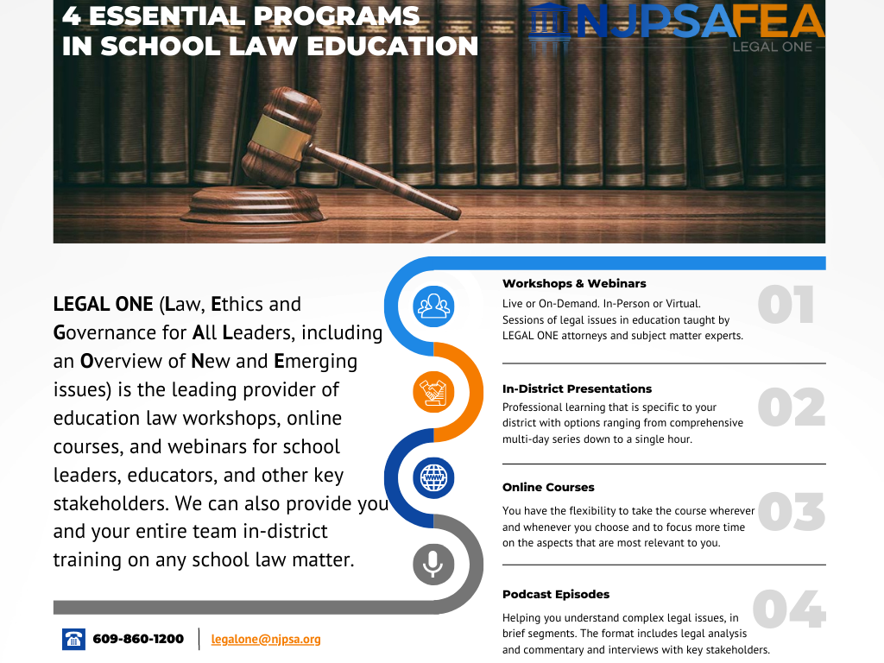

Slide 79








About the LEGAL ONE PODCAST
As the leading provider of school law training, the LEGAL ONE team of school law experts is pleased to offer the LEGAL ONE Podcast, a weekly podcast that helps you understand complex legal issues. Each episode is hosted by a LEGAL ONE attorney and/or an attorney working in partnership with LEGAL ONE. The format includes legal analysis and commentary and interviews with key stakeholders.
Available in Apple Podcasts and Spotify
LISTEN NOW

Slide 80
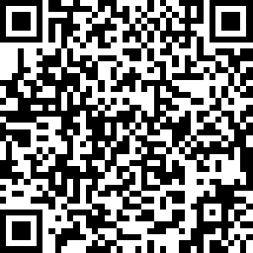
Certificate & Evaluation
Today’s professional development certificate is available to save/download at the end of a brief evaluation.
https://www.surveymonkey.com/r/LO-AJG-240812
Please take a few minutes to let us know what you thought of the session!

